Slide 1
JIRA TPM PRACTICAL PROJECT
AI-Powered Customer
Support Platform
End-to-end Technical Program Management in Jira Cloud — backlog, sprint execution, dependencies, risk, JQL, reporting and executive dashboarding, evidenced by 80 screenshots.
Prepared by
Mahesh Zade
ATSL
AI TPM Scrum Lab
KAN
DevOps & Cloud IT
Mahesh Zade • AI TPM / Jira Delivery Project
1
Notes:
Title slide. AI TPM / Jira delivery project prepared by Mahesh Zade.

Slide 2
CONTENTS
What this deck covers
1
2
3
Delivery Model
Backlog to Sprint
Dependencies & Risk
Project context, Jira operating model and how the ATSL and KAN environments were set up and run.
User stories, acceptance criteria, story points, sprint planning and sprint execution.
Blocking links, the ATSL-5 delivery risk, mitigation, escalation and checkpoints.
4
5
6
JQL & Reporting
Screenshot Evidence
TPM Interview Q&A
Queries, saved filters, burndown, sprint report, cumulative flow and status analysis.
All 80 Jira screenshots, arranged in delivery order with a written description for each.
Twelve TPM interview questions with model answers, plus two STAR delivery stories.
Mahesh Zade • AI TPM / Jira Delivery Project
2
Notes:
Agenda for the deck.

Slide 3
PART 1
Project, Delivery and Reporting
How the AI support-triage programme was planned, executed, risk-managed and reported inside Jira Cloud.
Mahesh Zade • AI TPM / Jira Delivery Project
3
Notes:
Part 1: Project, Delivery and Reporting

Slide 4
PART 1 · OVERVIEW
Executive project overview
A single TPM owned an AI support-triage programme end to end in Jira Cloud: two projects, ten tracked work items, one live delivery risk and an executive dashboard built on saved JQL filters.
10
2
13
80
1
work items tracked
across both projects
Jira projects:
ATSL and KAN
story points committed
to Sprint 1
screenshots captured
as delivery evidence
escalated delivery risk
(ATSL-5)
1
Objective. Demonstrate practical TPM ownership from backlog through to executive reporting.
2
Primary environment. AI TPM Scrum Lab (ATSL) — a Scrum project for AI capability delivery.
3
Supporting environment. My DevOps and Cloud IT Team (KAN) — Kanban flow for cloud infrastructure.
4
Evidence standard. Every claim in this deck maps to a numbered Jira screenshot in Part 2.
Mahesh Zade • AI TPM / Jira Delivery Project
4
Notes:
Executive overview of the programme and its scale.

Slide 5
PART 1 · CONTEXT
Business problem and product context
The problem
The delivery response
Cloud support teams receive high ticket volume that must be classified before it can be actioned.
Priority is assigned inconsistently, so critical issues are not always handled first.
Tickets reach the wrong team, adding a routing hop and delaying resolution.
Customer sentiment is invisible until a complaint escalates.
AI classification of incoming tickets by category (ATSL-1).
AI priority prediction with a manager review step (ATSL-2).
Automatic routing to the correct support team with an audit log (ATSL-3).
Sentiment analysis held back as a deliberate scope decision (ATSL-4).
What success means here. Transparent scope, an accountable owner on every item, measurable progress against a sprint goal, and delivery risk that is visible and managed rather than discovered late.
Mahesh Zade • AI TPM / Jira Delivery Project
5
Notes:
Business problem and the product response.

Slide 6
PART 1 · METHOD
The Jira operating model
Every work item follows the same path, so status in Jira always means the same thing to Product, Engineering and the executive audience.
Epic /
Parent
User
Story
Acceptance
Criteria
Subtasks
Sprint
Delivery
Evidence
A
B
C
D
Status flow
Explicit links
Owned risk
Live reporting
To Do → In Progress → Done. Three states only, so the board stays readable and the cumulative flow diagram stays meaningful.
Dependencies are recorded with the 'is blocked by' link type, never left buried in a comment thread.
Every risk carries an owner, an impact statement, a mitigation and a dated checkpoint.
Saved JQL filters feed dashboard gadgets, so the stakeholder view refreshes itself.
Mahesh Zade • AI TPM / Jira Delivery Project
6
Notes:
The operating model that every work item follows.

Slide 7
PART 1 · ENVIRONMENTS
Two Jira environments, one delivery story
ATSL — AI TPM Scrum Lab (Scrum)
KAN — DevOps and Cloud IT Team (Kanban)
Sprint-based delivery of AI capabilities, created with project key ATSL and lead Mahesh Zade.
Four user stories, story points, a two-week ATSL Sprint 1 and a formal sprint goal.
Burndown, sprint report, velocity and cumulative flow reporting available.
Home of the escalated delivery risk ATSL-5.
Continuous flow for cloud infrastructure work: To Do, In Progress, Waiting for Customer, Resolved.
KAN-4 parent item provisions EC2 and S3 for the Customer Stack application.
Subtasks KAN-6 to KAN-9 break the work down to implementable units.
Home of the blocked item KAN-8, configured security group.
Why two environments? A TPM rarely owns one methodology. Running Scrum and Kanban side by side shows that dependency, risk and reporting practice transfer across both — the mechanics differ, the accountability does not.
Mahesh Zade • AI TPM / Jira Delivery Project
7
Notes:
Comparison of the two Jira environments.

Slide 8
PART 1 · KAN
Cloud and DevOps work breakdown
KAN-4 · Parent work item
Provision EC2 and S3 for the Customer Stack application
KAN-6
Create AWS EC2 instance
In Progress
KAN-7
Create S3 bucket
To Do
REQUIREMENTS
Create an EC2 instance and an S3 bucket, configure security groups, allow SSH access, verify connectivity and document the result.
KAN-8
Configure EC2 security group
Blocked by KAN-6
KAN-9
Document AWS infrastructure
To Do
LABELS
AWS, EC2, devops, infrastructure and s3 — so the work is queryable by technology, not only by project.
1
The dependency. KAN-6 blocks KAN-8 — a security group cannot be attached to an instance that does not exist yet.
OWNERSHIP
Assignee and reporter set to Mahesh Zade, priority High, with four subtasks tracked to a completion percentage.
2
Why it matters. Without the link, KAN-8 looks independently deliverable and gets pulled into the wrong week.
3
How it is tracked. Recorded with the 'is blocked by' link type and queried with workItemLinkType in JQL.
Mahesh Zade • AI TPM / Jira Delivery Project
8
Notes:
KAN work breakdown and the KAN-6 to KAN-8 dependency.

Slide 9
PART 1 · ATSL
The AI Scrum backlog
KEY
USER STORY
PTS
STATUS
ATSL-1
AI ticket classification
5
Done
ATSL-2
AI ticket priority prediction
3
In Progress · blocked by API risk
ATSL-3
AI ticket routing to correct team
5
To Do · 4 subtasks
ATSL-4
Customer sentiment analysis
—
Backlog · out of Sprint 1 scope
The scope decision. ATSL-4 was written, estimated and then deliberately left out of Sprint 1. Holding it in the backlog is the decision — an unwritten story is not scope control, it is an omission.
Mahesh Zade • AI TPM / Jira Delivery Project
9
Notes:
The four ATSL stories, their points and status.

Slide 10
PART 1 · QUALITY
What makes these user stories usable
As a Cloud Support Manager, I want AI to predict the priority of incoming support tickets, so that critical issues can be handled faster.
ACCEPTANCE CRITERIA — ATSL-2
1
Identify. AI identifies Critical, High, Medium or Low priority for every incoming ticket.
Observable
✓
Criteria describe behaviour you can watch happen, not code you have to read.
2
Recommend. AI assigns a priority recommendation rather than silently overwriting the field.
3
Review. The support manager can review and override the recommendation.
✓
Testable
QA can turn each line into a test case without asking a follow-up question.
4
Record. The priority prediction is recorded against the ticket for later accuracy analysis.
✓
Shared
Engineering, QA and Product hold the same definition of done before work starts.
Mahesh Zade • AI TPM / Jira Delivery Project
10
Notes:
Story format and acceptance criteria quality.

Slide 11
PART 1 · PLANNING
Sprint planning and commitment
SPRINT 1 GOAL
Deliver core AI-powered support-ticket triage: classification, priority prediction and automatic routing.
13
3
2
1
story points committed
to Sprint 1
stories pulled into
the sprint
week sprint
duration
sprint goal, stated
before work began
1
Capacity before content. Commitment was sized against a two-week window, not against how much work existed.
2
A goal, not a list. The sprint goal is a delivered capability, so partial completion can still be judged against intent.
3
Scope held back on purpose. ATSL-4 sentiment analysis stayed in the backlog to protect the goal.
4
Dependencies named at planning. The AI Prediction API risk and the routing-rule dependency were raised before the sprint started, not mid-sprint.
5
Sprint 2 continued the thread. Priority prediction and routing carried forward with the API and routing-rule dependencies actively managed.
Mahesh Zade • AI TPM / Jira Delivery Project
11
Notes:
Sprint planning, commitment and goal.

Slide 12
PART 1 · EXECUTION
Sprint execution and flow
TO DO
IN PROGRESS
DONE
ATSL-3 · routing
ATSL-2 · priority prediction
ATSL-1 · classification
Mid-sprint snapshot: exactly one story in each state. Limited work in progress keeps the cumulative flow diagram readable and makes a bottleneck obvious the moment it appears.
1
2
3
4
Visible progress
Subtask granularity
Honest dependencies
An audit trail
Completed work moves to Done; active work stays visible in In Progress rather than being reported verbally.
Subtasks expose implementation progress underneath a parent story that would otherwise look static for days.
A blocked story is not counted as independently deliverable, however close to done it looks.
Status changes and structured comments give stakeholder communication a record to point at.
Mahesh Zade • AI TPM / Jira Delivery Project
12
Notes:
Sprint execution and flow discipline.

Slide 13
PART 1 · DEPENDENCIES
Dependency management in practice
The AI Prediction API may not be ready in time for priority prediction integration.
ATSL-5
blocks →
ATSL-2
Routing logic cannot be implemented until routing rules and team mapping are finalised.
ATSL-7
blocks →
ATSL-8
The EC2 security group cannot be configured before the EC2 instance exists.
KAN-6
blocks →
KAN-8
THE TPM SEQUENCE
Identify
Link in
Jira
Assess
impact
Assign
owner
Mitigate
Checkpoint
Mahesh Zade • AI TPM / Jira Delivery Project
13
Notes:
Three real dependencies and the TPM sequence for handling them.

Slide 14
PART 1 · RISK
Risk management: ATSL-5
ATSL-5 · RISK · HIGH IMPACT AI Prediction API may not be available on time
I
O
M
C
Impact
Owner
Mitigation
Checkpoint
ATSL-2 priority prediction may be delayed, which puts the Sprint 1 delivery goal at risk.
Named engineering owner in the AI/ML team, recorded on the work item rather than agreed verbally.
Confirm API availability and the integration contract; build against a mock API in parallel so work continues.
A dated readiness confirmation covering authentication, response format and latency.
1
Risk comments are status updates. Each comment on ATSL-5 states blocker, impact, owner, mitigation and target — structured, not conversational.
2
A risk stays open until it is validated. The blocker is cleared when the dependency is proven to work, not when someone reports that it is ready.
3
The risk is queryable. Labelled so the saved filter TPM - AI Risks surfaces it on the dashboard without manual curation.
Mahesh Zade • AI TPM / Jira Delivery Project
14
Notes:
The ATSL-5 risk, its mitigation and checkpoint.

Slide 15
PART 1 · ESCALATION
A repeatable escalation pattern
The same five-part structure was used for every escalation, so stakeholders always receive a decision request rather than a status complaint.
1
2
3
Risk statement
Impact
Escalation
What may happen, and why it matters to the delivery outcome — in one sentence, in business language.
The specific story, sprint or downstream capability affected, named rather than implied.
The responsible engineering or team owner, and the exact decision being asked for.
4
5
6
Recovery plan
Next checkpoint
Close the loop
Parallelise, mock the dependency, resequence delivery, or communicate a schedule change.
A concrete date or trigger. Without it, the escalation quietly expires.
State publicly when the risk is validated and cleared, so trust in the reporting survives.
Mahesh Zade • AI TPM / Jira Delivery Project
15
Notes:
Five-part escalation pattern used consistently.

Slide 16
PART 1 · JQL
JQL used on this project
1
project = ATSL AND status = "In Progress"
What is actively being worked on right now
2
project = ATSL AND status != Done
All outstanding delivery work
3
project = ATSL AND priority in (Highest, High)
What deserves attention first
4
project = ATSL AND assignee = currentUser()
Personal execution view
5
project = KAN AND workItemLinkType = "is blocked by"
Every blocked item in the cloud workstream
6
project = KAN ORDER BY Rank ASC
The ranked backlog in delivery order
A negative result is still evidence: running the blocked-by query against ATSL returned no rows, which proved the dependency lived in the KAN project rather than being missing altogether.
Mahesh Zade • AI TPM / Jira Delivery Project
16
Notes:
The six JQL queries used and what each answers.

Slide 17
PART 1 · FILTERS
Saved filters as reusable data sources
TPM - AI Risks
project = ATSL AND labels = risk
Surfaces ATSL-5 on the dashboard automatically, with no manual curation.
F
TPM - High Priority Open Work
High-priority unresolved delivery work
Answers 'what is urgent' in one click for any stakeholder.
F
TPM - KAN Blockers
project = KAN AND workItemLinkType = "is blocked by"
Answers 'what is blocked' for the cloud workstream.
F
AI TPM Scrum Practice
project = KAN ORDER BY Rank ASC
The ranked master list feeding the dashboard filter gadget.
F
A saved filter is the difference between a report someone has to rebuild and a report that maintains itself.
Mahesh Zade • AI TPM / Jira Delivery Project
17
Notes:
Four saved filters and why each exists.

Slide 18
PART 1 · REPORTING
Reading the burndown and sprint report
The flat line is the signal. Points only dropped when ATSL-1 completed; the plateau after it is the API dependency, not slow engineering.
1
Burndown asks, it does not answer. Is scope changing, is delivery slower, or is a dependency constraining throughput? The chart cannot tell you which.
2
The sprint report pairs with it. ATSL-1 completed and closed at 5 points; ATSL-2 and ATSL-3 carried, each with a stated reason.
3
Never report the chart alone. A deviation without a root cause is a number, not a status update.
4
Sprint Report outcome. Completed: ATSL-1 (5 pts, Done). Not completed: ATSL-2 (In Progress, blocked by the API risk) and ATSL-3 (To Do, awaiting routing rules). Both carried forward with a documented reason rather than a silent rollover.
What was actually reported. Goal partially met, one story delivered, one dependency-blocked, and a dated API checkpoint agreed with the engineering owner.
5
Mahesh Zade • AI TPM / Jira Delivery Project
18
Notes:
Burndown interpretation and the sprint report outcome.

Slide 19
PART 1 · FLOW
Cumulative flow and status analysis
Accumulation, not activity. Cumulative flow shows how work piles up in each status over time — the shape matters more than any single day.
1
A widening band is a bottleneck. In Progress growing while Done stays flat means intake is outrunning completion.
2
Stable flow is balanced. Intake, execution and completion have to move at comparable rates or the board stops predicting anything.
3
The status split is the executive view. 10 items — 5 To Do, 3 In Progress, 2 Done — is the one number an executive audience actually retains.
4
Read together: the burndown says whether the sprint will land, cumulative flow says why, and the status split says what to tell the executive audience.
Mahesh Zade • AI TPM / Jira Delivery Project
19
Notes:
Cumulative flow and what status distribution tells a TPM.

Slide 20
PART 1 · DASHBOARD
Designing the AI TPM Delivery Dashboard
Every gadget on the dashboard answers one standing TPM question. Gadgets that answered nothing were removed, because dashboard noise is indistinguishable from dashboard failure.
What is progressing?
What is urgent?
What is risky?
What is blocked?
What do I own?
Status Pie Chart
TPM - High Priority Open Work
TPM - AI Risks
TPM - KAN Blockers
Assigned to Me
Status distribution across all ten tracked work items.
High-priority unresolved items, currently surfacing the ATSL-5 risk.
Label-driven risk view showing ATSL-5 and its live status.
Blocked-by query surfacing KAN-8 in the cloud workstream.
Personal execution visibility across both projects.
1
Filters first, gadgets second. Each gadget points at a saved filter, so the query logic lives in one place and can be reused elsewhere.
2
Built for a question, not a screenshot. The dashboard is an operating mechanism reviewed in stand-ups, not an artefact produced for a report.
Mahesh Zade • AI TPM / Jira Delivery Project
20
Notes:
Dashboard design principles and the five gadgets.

Slide 21
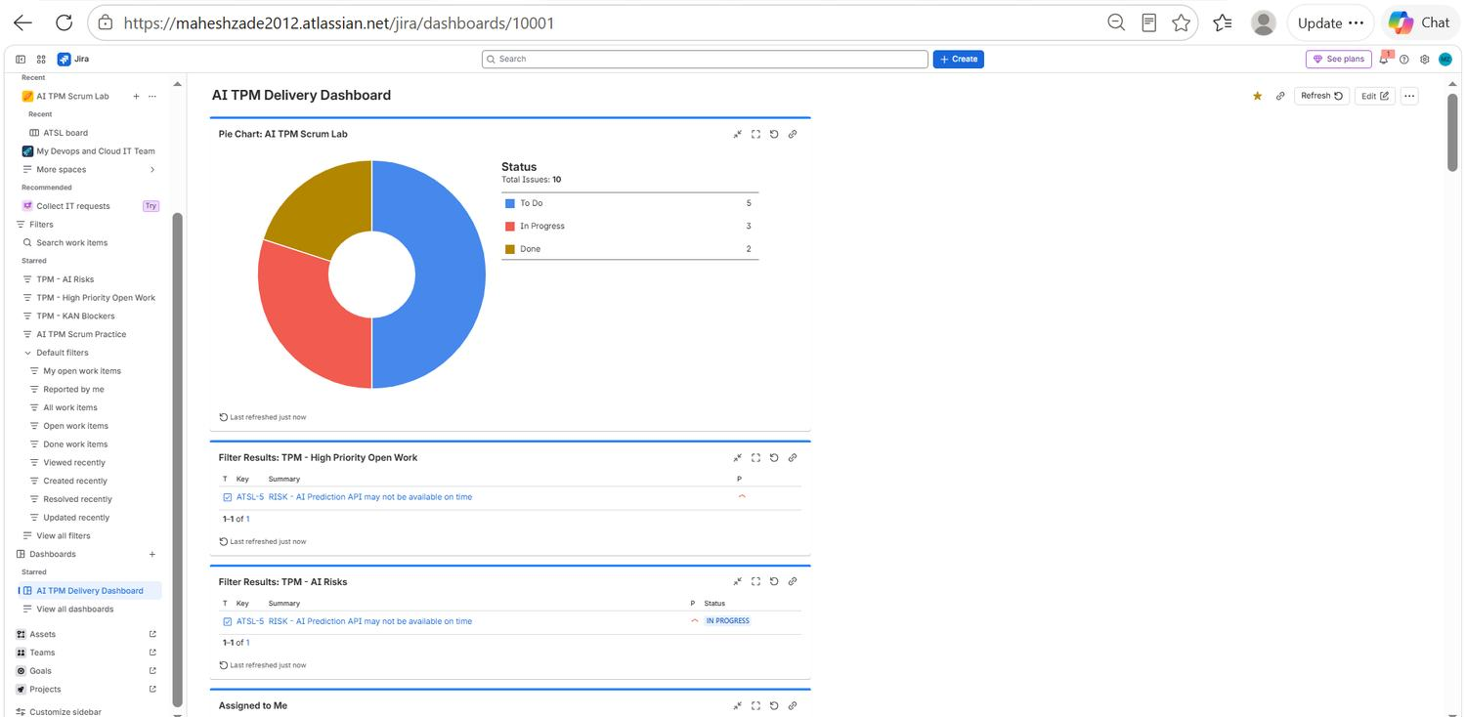
PART 1 · RESULT
Final dashboard snapshot
1
5 To Do Work not yet started, including held-back scope.
2
3 In Progress Active work, one of which is dependency-constrained.
3
2 Done Delivered and accepted against acceptance criteria.
EVID-080 · Final AI TPM Delivery Dashboard
4
ATSL-5 The single open high-impact risk, visible to every stakeholder.
Mahesh Zade • AI TPM / Jira Delivery Project
21
Notes:
Final dashboard: 10 items, 5 To Do, 3 In Progress, 2 Done.

Slide 22
PART 1 · METRICS
TPM metrics worth monitoring
D
F
R
Delivery
Flow
Risk
Story points completed against committed. Sprint goal achieved or not — a binary answer, stated plainly.
Work in progress, cycle time and throughput. Rising WIP with flat throughput is the early warning.
Count of open high-impact risks and the age of critical dependencies. Age matters more than count.
Q
S
A
Quality
Stakeholder health
AI-specific
Acceptance criteria completion and reopened work. Reopened items are the honest quality signal.
Decisions pending, escalations raised and checkpoint adherence. Missed checkpoints predict surprises.
Data readiness, model evaluation scores, routing accuracy and priority prediction precision and recall.
Mahesh Zade • AI TPM / Jira Delivery Project
22
Notes:
Six metric families a TPM should watch.

Slide 23
PART 1 · COMMUNICATION
One programme, four stakeholder narratives
The facts stay identical. What changes is which fact leads, because each audience can only act on the part of the picture they control.
Executive
Product
Engineering
Support / Operations
Outcome, delivery health, the top risk and the decision required. Business impact first, Jira mechanics never.
Scope, customer impact, priority and the trade-off being made to protect the sprint goal.
The dependency, the technical owner, the integration contract and the acceptance criteria.
Readiness, runbook, incident impact and a clean handoff at the point of release.
The RAG discipline. Lead with the outcome, then progress, then the top risk, then the decision needed, then the next milestone. Uncertainty is never hidden — it is stated with an owner, a mitigation and a date. A status report that only contains good news stops being read.
Mahesh Zade • AI TPM / Jira Delivery Project
23
Notes:
Tailoring the same facts to four audiences.

Slide 24
PART 2
Screenshot Evidence Archive
All 80 Jira screenshots, arranged in delivery order, each with an EVID reference and a description of what it demonstrates.
Mahesh Zade • AI TPM / Jira Delivery Project
24
Notes:
Part 2: Screenshot Evidence Archive

Slide 25
PART 2 · INDEX
How the 80 screenshots are arranged
The archive is presented in delivery order — environment setup first, then backlog and planning, then sprint execution, then reporting and the dashboard build. Every screenshot carries an EVID number, a title and a description of exactly what it proves.
EVID-001 → 012
Cloud & DevOps Environment (KAN)
Parent item, subtasks, the blocking dependency and the Kanban board.
EVID-013 → 021
Board and Project Setup
Board creation, Scrum vs Kanban, project creation and the first saved filter.
EVID-022 → 033
AI Scrum Backlog and Planning
User stories, acceptance criteria, estimation and sprint scope decisions.
EVID-034 → 047
Sprint Execution and Reporting
Sprint start, blocker comments, burndown, sprint report and flow charts.
EVID-048 → 078
JQL, Filters and Dashboard Build
Queries, saved filters, gadget configuration and dashboard assembly.
EVID-079 → 080
Final Delivery Dashboard
The status chart configuration and the completed executive dashboard.
Mahesh Zade • AI TPM / Jira Delivery Project
25
Notes:
Index of the evidence archive.

Slide 26
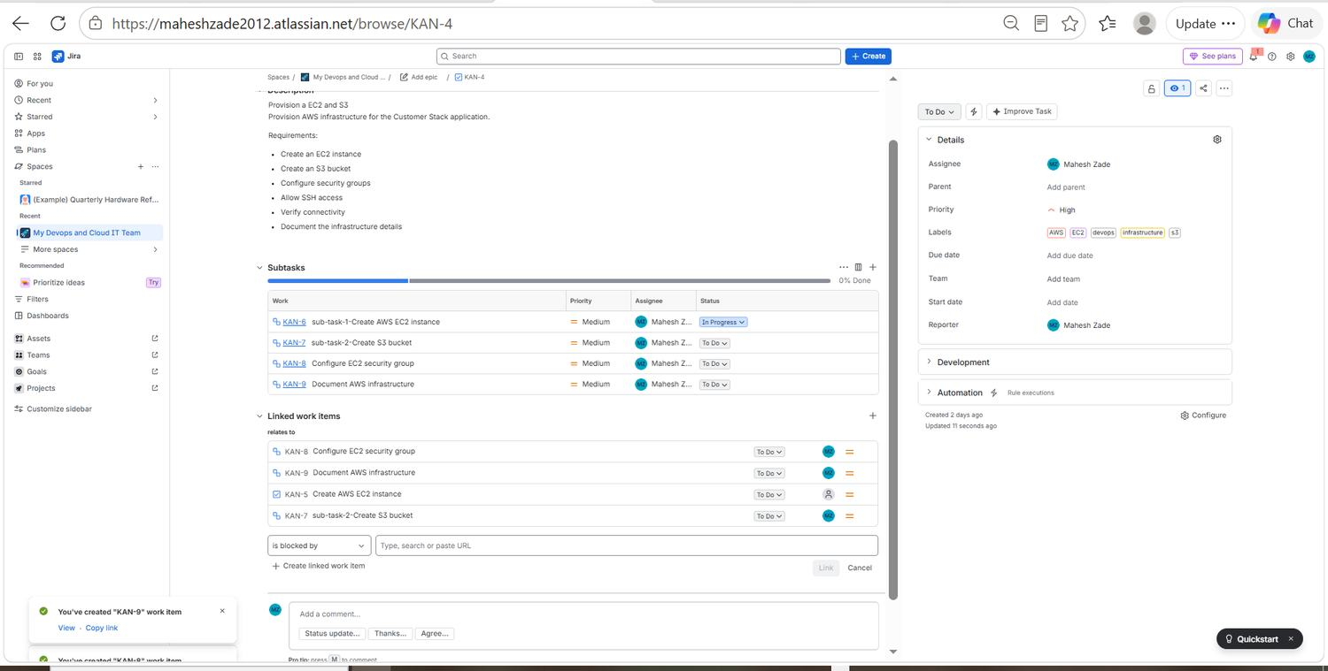
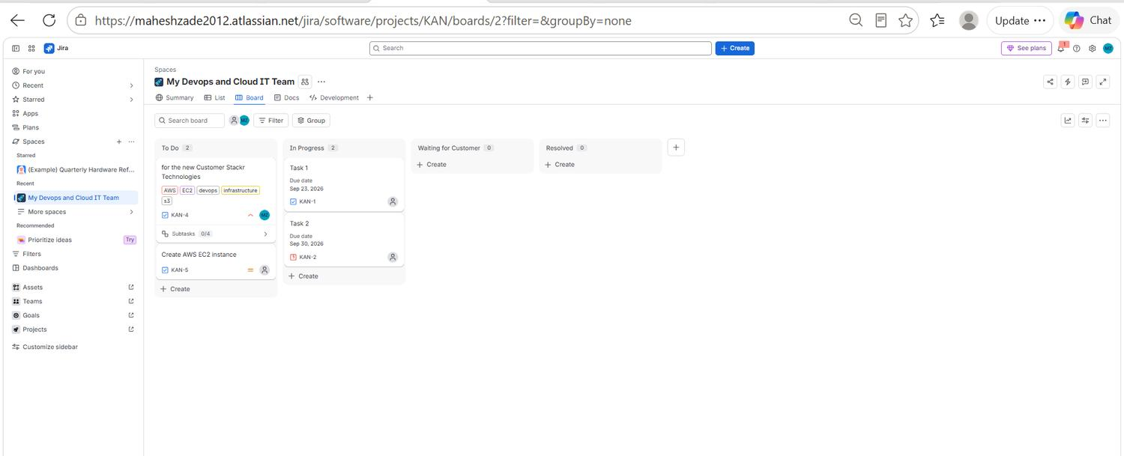
EVIDENCE 01 / 40
Cloud & DevOps Environment (KAN)
EVID-001
KAN-4 parent task and its subtasks
EVID-002
Kanban board for the DevOps team
Cloud infrastructure parent work item KAN-4 with four subtasks (KAN-6 to KAN-9) and the Linked work items panel open, where the 'is blocked by' dependency is created.
Board for 'My Devops and Cloud IT Team' showing the To Do, In Progress, Waiting for Customer and Resolved columns with live work items.
Mahesh Zade • AI TPM / Jira Delivery Project
26
Notes:
EVID-001: KAN-4 parent task and its subtasks. Cloud infrastructure parent work item KAN-4 with four subtasks (KAN-6 to KAN-9) and the Linked work items panel open, where the 'is blocked by' dependency is created. EVID-002: Kanban board for the DevOps team. Board for 'My Devops and Cloud IT Team' showing the To Do, In Progress, Waiting for Customer and Resolved columns with live work items.

Slide 27
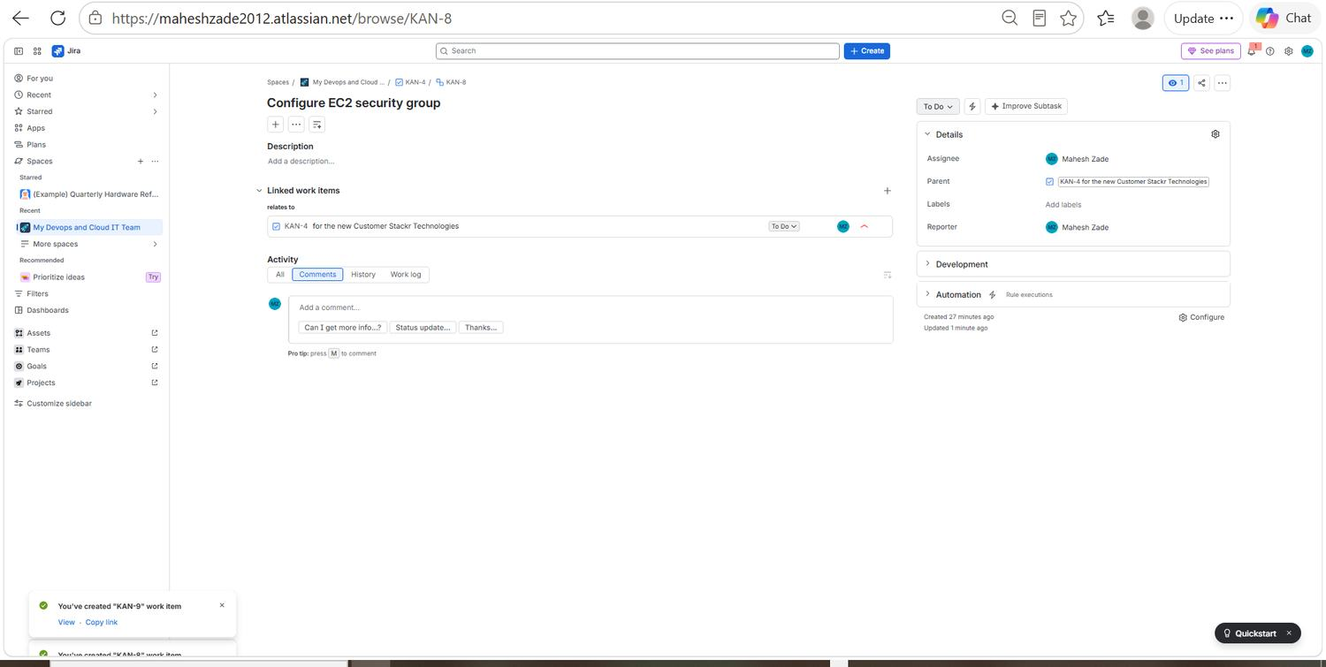
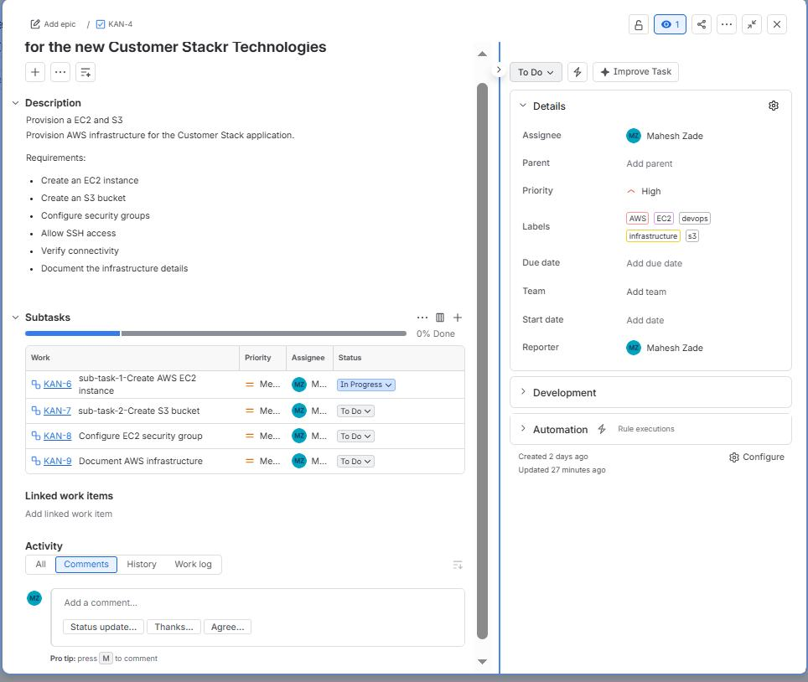
EVIDENCE 02 / 40
Cloud & DevOps Environment (KAN)
EVID-003
KAN-8 security group task
EVID-004
KAN-4 scope and requirements
KAN-8 'Configure EC2 security group' opened full screen. The Linked work items section records that it is blocked by the EC2 instance subtask.
Close-up of the KAN-4 description: provision EC2 and S3 for the Customer Stack application, with six explicit requirements listed as a checklist.
Mahesh Zade • AI TPM / Jira Delivery Project
27
Notes:
EVID-003: KAN-8 security group task. KAN-8 'Configure EC2 security group' opened full screen. The Linked work items section records that it is blocked by the EC2 instance subtask. EVID-004: KAN-4 scope and requirements. Close-up of the KAN-4 description: provision EC2 and S3 for the Customer Stack application, with six explicit requirements listed as a checklist.

Slide 28
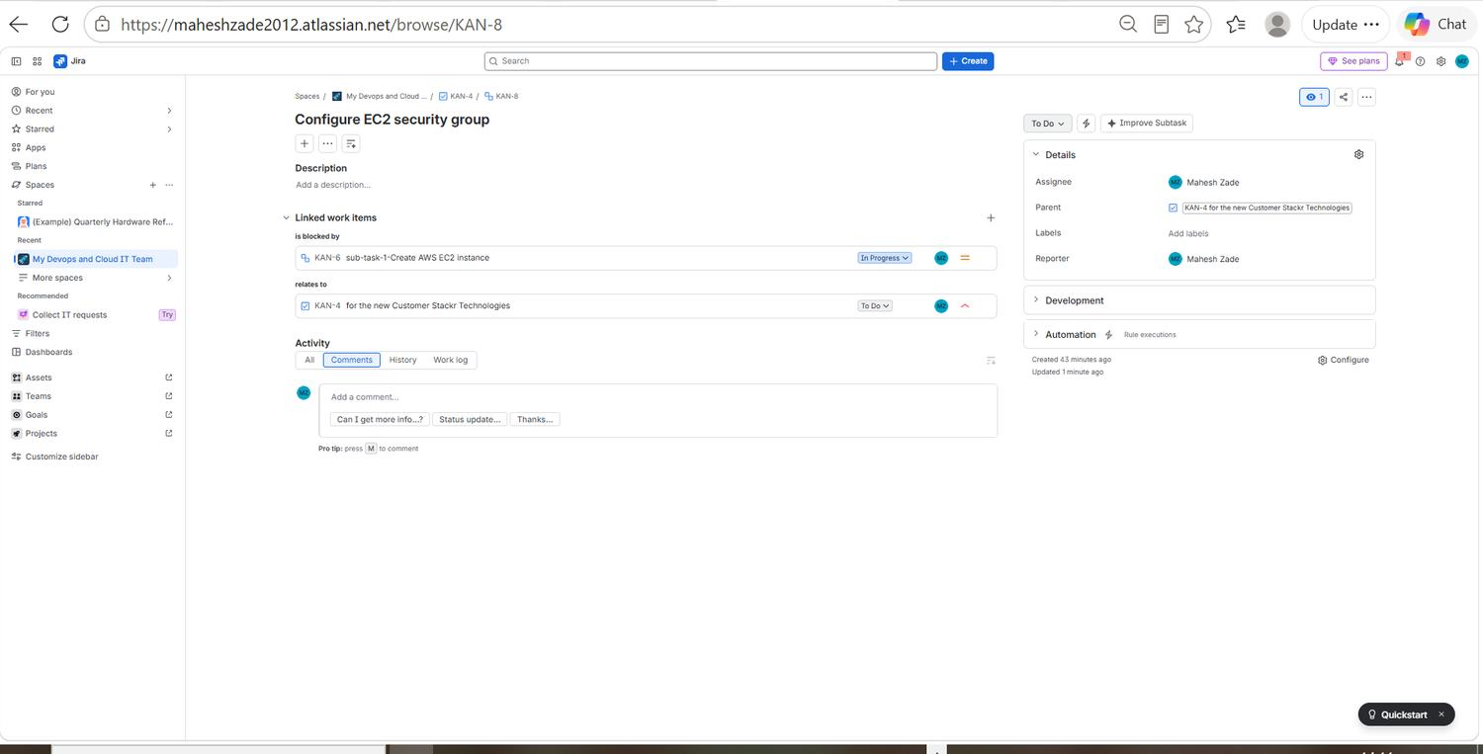
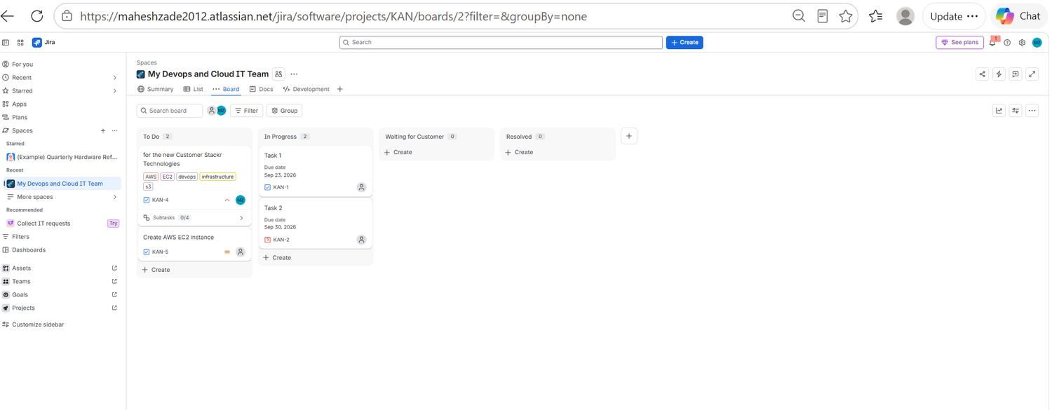
EVIDENCE 03 / 40
Cloud & DevOps Environment (KAN)
EVID-005
Confirmed blocking dependency
EVID-006
Board work distribution
The dependency on KAN-8 confirmed in Jira: 'is blocked by' KAN-6 sub-task-1 Create AWS EC2 instance, with status and assignee visible.
Board view showing KAN-4 held in To Do while Task 1, Task 2 and Create AWS EC2 instance move through In Progress.
Mahesh Zade • AI TPM / Jira Delivery Project
28
Notes:
EVID-005: Confirmed blocking dependency. The dependency on KAN-8 confirmed in Jira: 'is blocked by' KAN-6 sub-task-1 Create AWS EC2 instance, with status and assignee visible. EVID-006: Board work distribution. Board view showing KAN-4 held in To Do while Task 1, Task 2 and Create AWS EC2 instance move through In Progress.

Slide 29
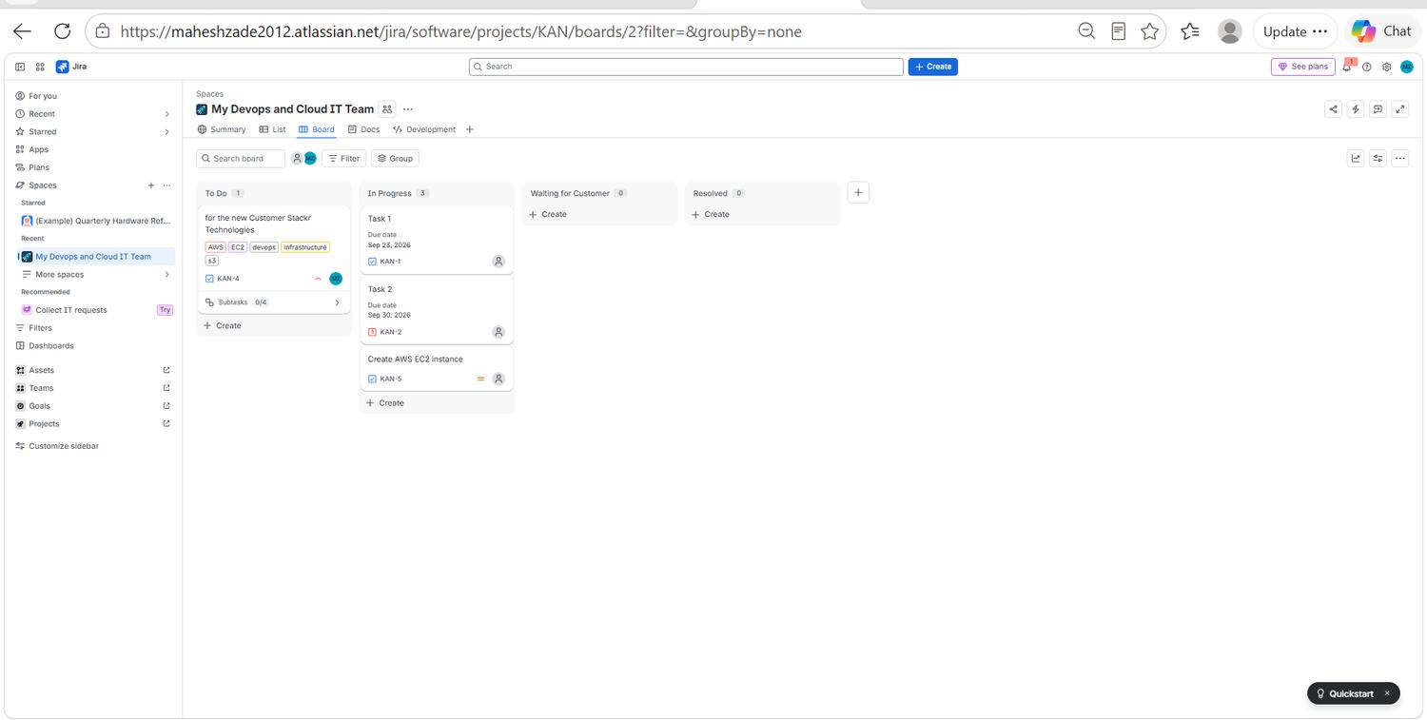
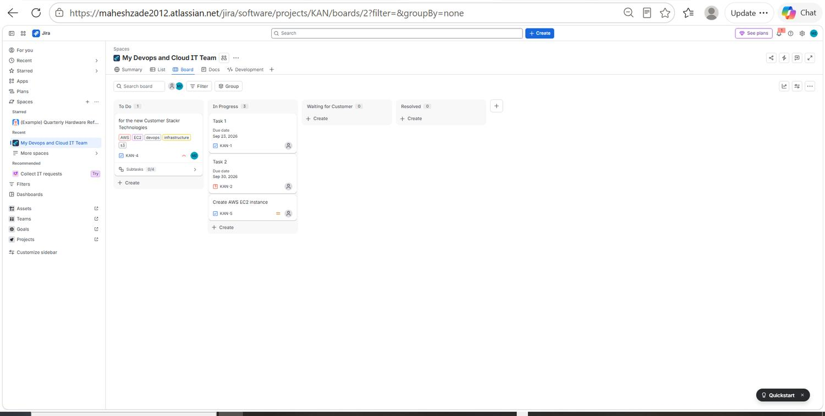
EVIDENCE 04 / 40
Cloud & DevOps Environment (KAN)
EVID-007
Full-width board snapshot
EVID-008
Labels and metadata on cards
Full-screen Kanban board confirming work-in-progress distribution across all four workflow columns of the KAN project.
The same board at full browser width, with the AWS, EC2, devops and infrastructure labels visible directly on the KAN-4 card.
Mahesh Zade • AI TPM / Jira Delivery Project
29
Notes:
EVID-007: Full-width board snapshot. Full-screen Kanban board confirming work-in-progress distribution across all four workflow columns of the KAN project. EVID-008: Labels and metadata on cards. The same board at full browser width, with the AWS, EC2, devops and infrastructure labels visible directly on the KAN-4 card.

Slide 30
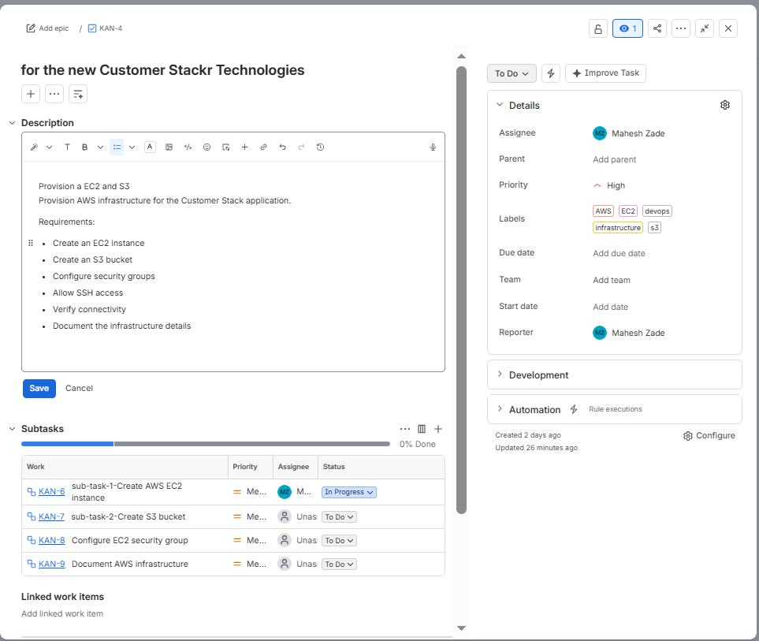
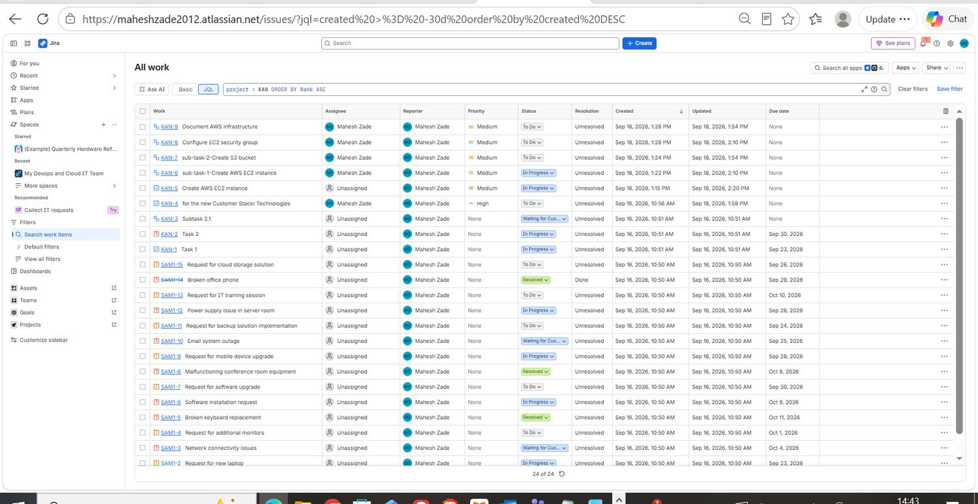
EVIDENCE 05 / 40
Cloud & DevOps Environment (KAN)
EVID-009
Editing the KAN-4 description
EVID-010
Cross-project work list
KAN-4 description in edit mode with the requirement checklist, alongside the subtask table showing 0% done at this point.
The 'All work' list view across both projects, sorted by creation date, used to verify that every created item was captured.
Mahesh Zade • AI TPM / Jira Delivery Project
30
Notes:
EVID-009: Editing the KAN-4 description. KAN-4 description in edit mode with the requirement checklist, alongside the subtask table showing 0% done at this point. EVID-010: Cross-project work list. The 'All work' list view across both projects, sorted by creation date, used to verify that every created item was captured.

Slide 31
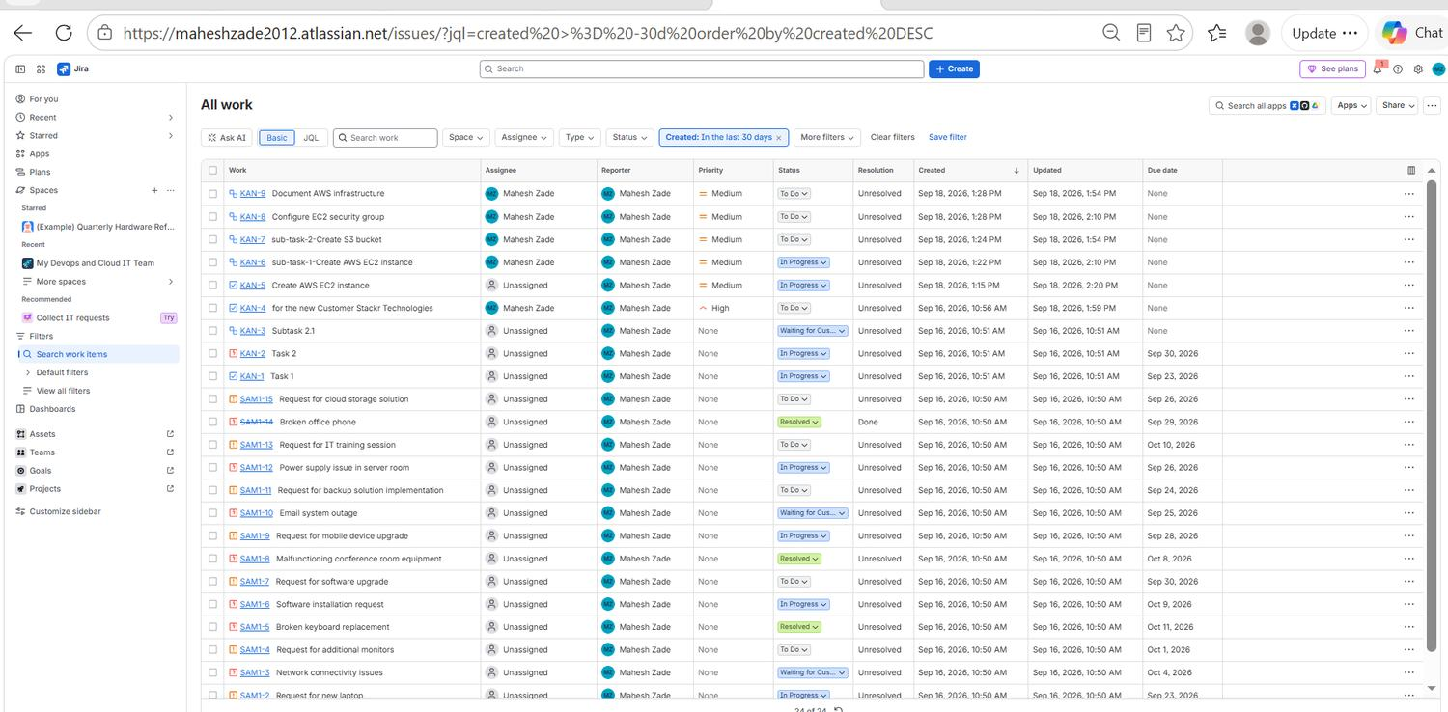
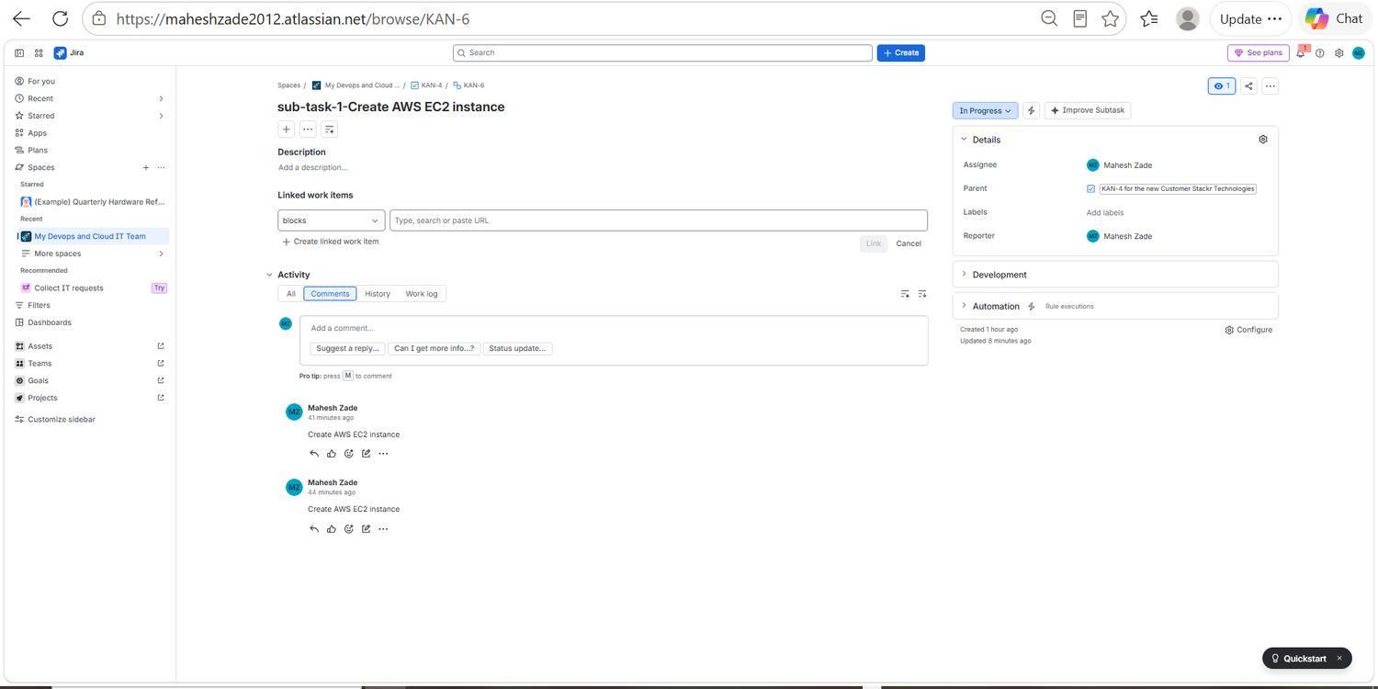
EVIDENCE 06 / 40
Cloud & DevOps Environment (KAN)
EVID-011
Work list detail columns
EVID-012
KAN-6 subtask activity trail
Full-width work list showing assignee, reporter, priority, status, resolution and created/updated timestamps for each item.
KAN-6 'sub-task-1 Create AWS EC2 instance' with its activity and comment trail, used as the running status record for the subtask.
Mahesh Zade • AI TPM / Jira Delivery Project
31
Notes:
EVID-011: Work list detail columns. Full-width work list showing assignee, reporter, priority, status, resolution and created/updated timestamps for each item. EVID-012: KAN-6 subtask activity trail. KAN-6 'sub-task-1 Create AWS EC2 instance' with its activity and comment trail, used as the running status record for the subtask.

Slide 32
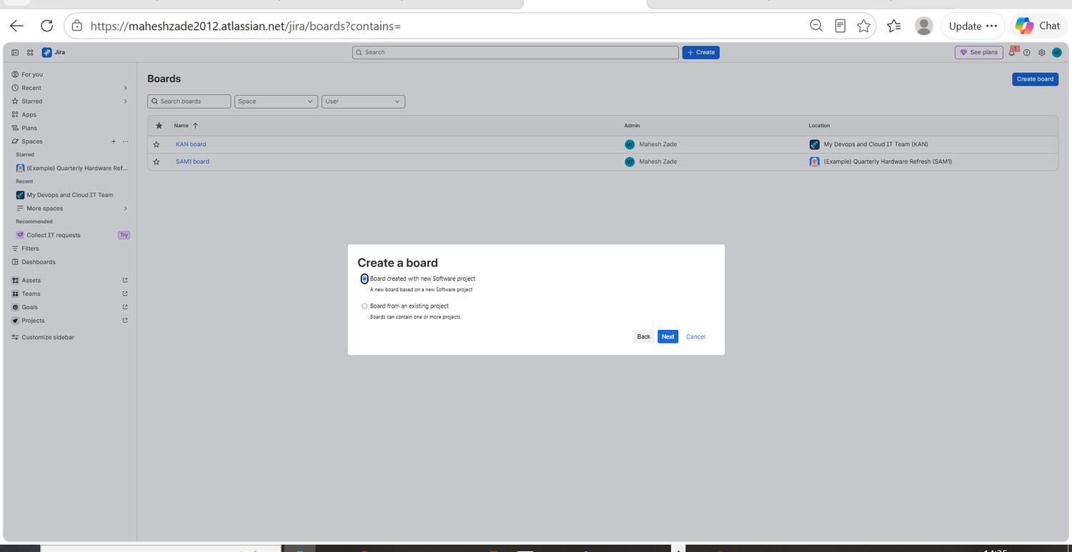
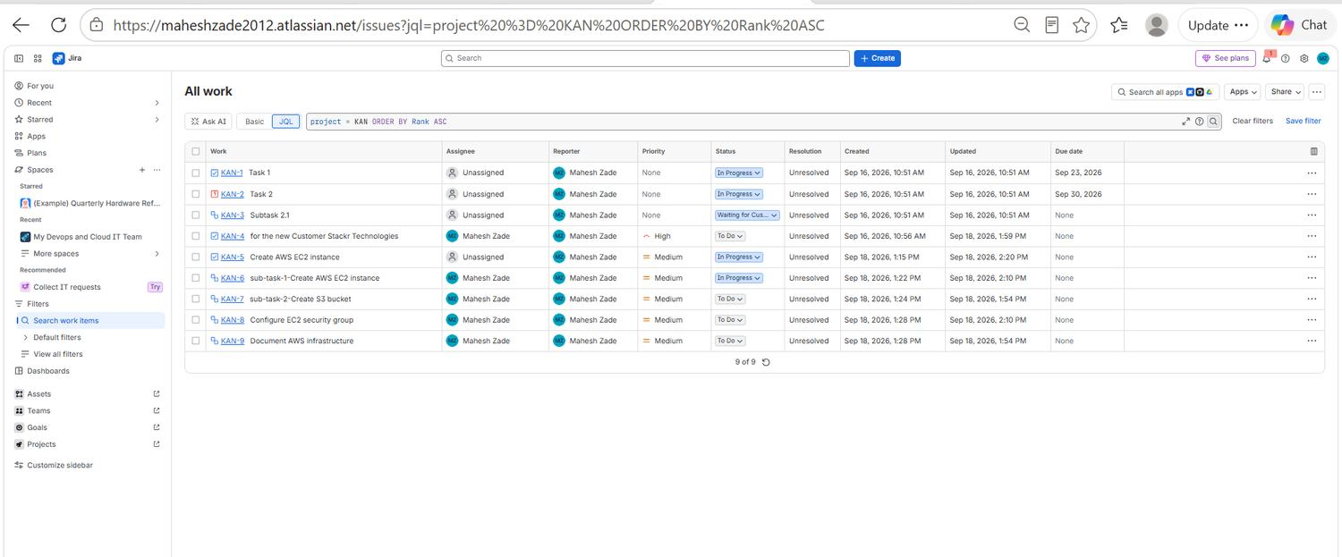
EVIDENCE 07 / 40
Board and Project Setup
EVID-013
Creating a board
EVID-014
Ranking the KAN backlog
The Jira Boards screen with the Create a board dialog open, offering a board on a new software project or a board from an existing project.
JQL query project = KAN ORDER BY Rank ASC returning all nine KAN work items in ranked delivery order.
Mahesh Zade • AI TPM / Jira Delivery Project
32
Notes:
EVID-013: Creating a board. The Jira Boards screen with the Create a board dialog open, offering a board on a new software project or a board from an existing project. EVID-014: Ranking the KAN backlog. JQL query project = KAN ORDER BY Rank ASC returning all nine KAN work items in ranked delivery order.

Slide 33
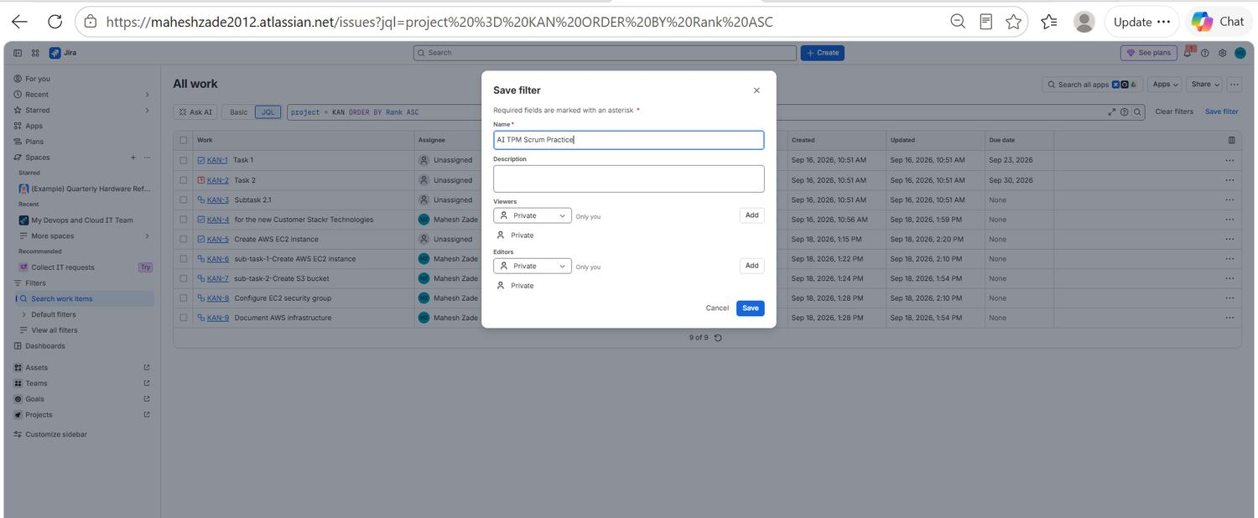
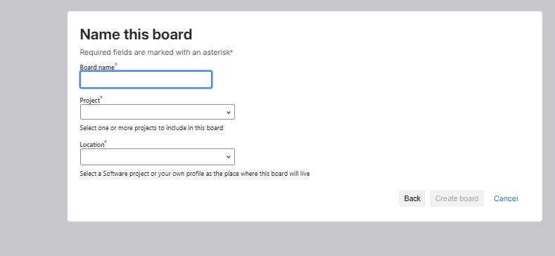
EVIDENCE 08 / 40
Board and Project Setup
EVID-015
Saving the first filter
EVID-016
Board creation wizard
Saving the KAN query as the reusable filter 'AI TPM Scrum Practice', with viewer and editor permissions set.
The board wizard requiring a board name, a project and a location before the board can be created.
Mahesh Zade • AI TPM / Jira Delivery Project
33
Notes:
EVID-015: Saving the first filter. Saving the KAN query as the reusable filter 'AI TPM Scrum Practice', with viewer and editor permissions set. EVID-016: Board creation wizard. The board wizard requiring a board name, a project and a location before the board can be created.

Slide 34
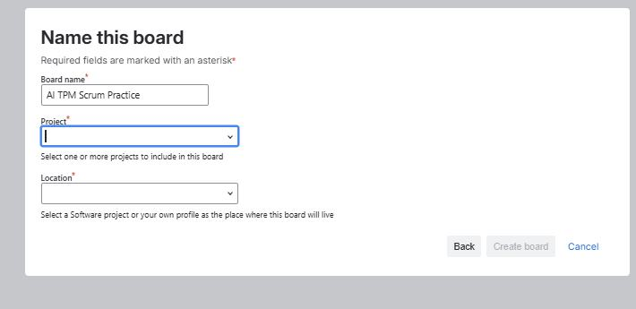
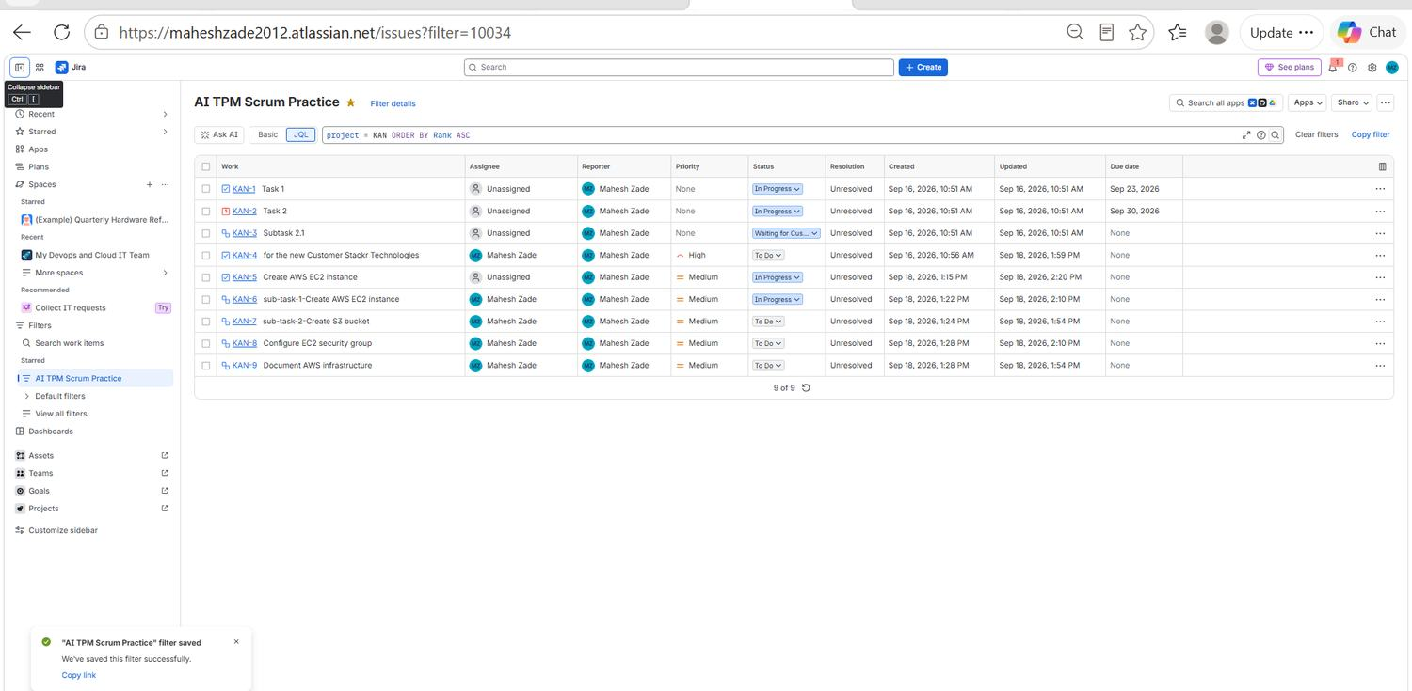
EVIDENCE 09 / 40
Board and Project Setup
EVID-017
Naming the practice board
EVID-018
Saved filter confirmed
Board name 'AI TPM Scrum Practice' entered in the wizard, with project and location still to be selected.
The saved filter opened from the sidebar; the confirmation toast shows the filter was stored successfully and can be reused.
Mahesh Zade • AI TPM / Jira Delivery Project
34
Notes:
EVID-017: Naming the practice board. Board name 'AI TPM Scrum Practice' entered in the wizard, with project and location still to be selected. EVID-018: Saved filter confirmed. The saved filter opened from the sidebar; the confirmation toast shows the filter was stored successfully and can be reused.

Slide 35
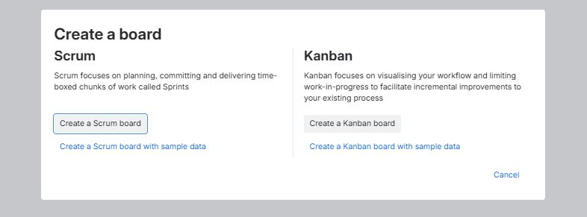
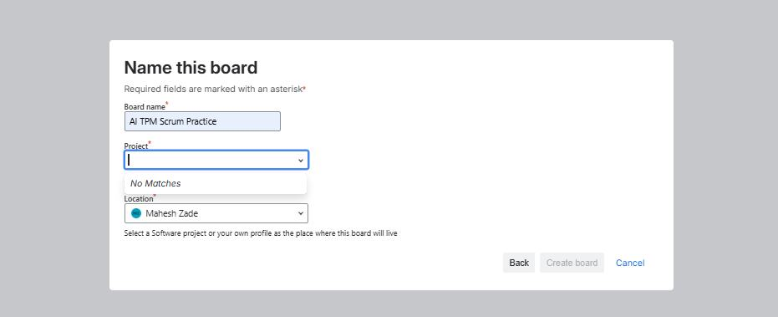
EVIDENCE 10 / 40
Board and Project Setup
EVID-019
Scrum or Kanban decision
EVID-020
No existing project matched
Choosing between a Scrum board (sprint-based, time-boxed commitment) and a Kanban board (continuous flow) for the practice project.
The board wizard returning 'No Matches' for an existing software project, which is what drove creation of a dedicated new project.
Mahesh Zade • AI TPM / Jira Delivery Project
35
Notes:
EVID-019: Scrum or Kanban decision. Choosing between a Scrum board (sprint-based, time-boxed commitment) and a Kanban board (continuous flow) for the practice project. EVID-020: No existing project matched. The board wizard returning 'No Matches' for an existing software project, which is what drove creation of a dedicated new project.

Slide 36
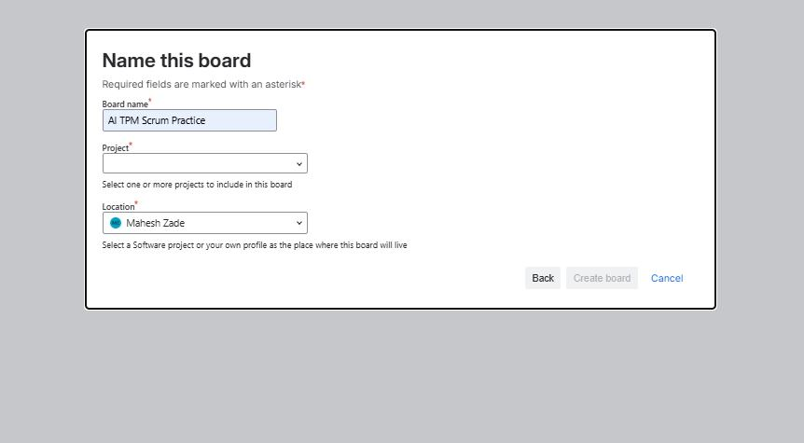
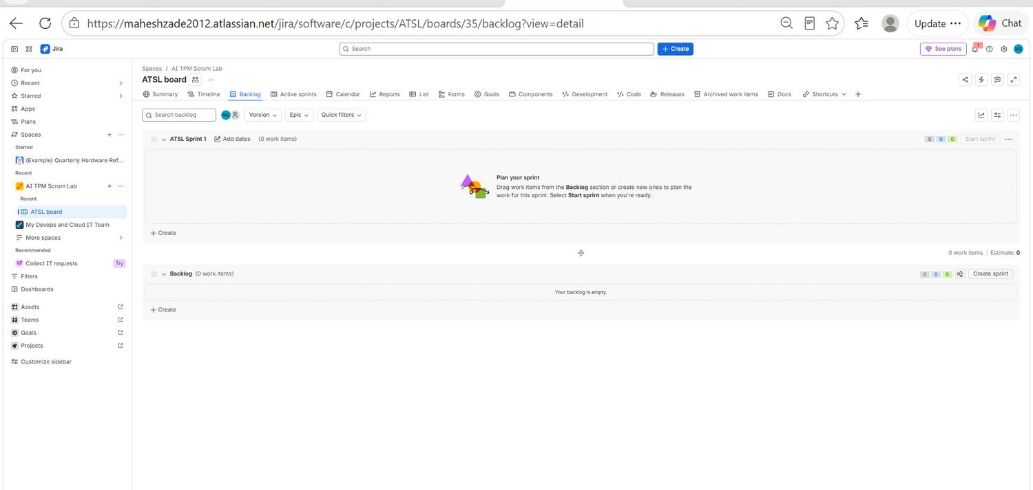
EVIDENCE 11 / 40
Board and Project Setup
EVID-021
Board location selected
EVID-022
Empty ATSL board
Board location set to the Mahesh Zade profile so the board could be created before the ATSL software project existed.
The newly created ATSL board: an empty ATSL Sprint 1 container and an empty backlog, ready for user stories to be written.
Mahesh Zade • AI TPM / Jira Delivery Project
36
Notes:
EVID-021: Board location selected. Board location set to the Mahesh Zade profile so the board could be created before the ATSL software project existed. EVID-022: Empty ATSL board. The newly created ATSL board: an empty ATSL Sprint 1 container and an empty backlog, ready for user stories to be written.

Slide 37
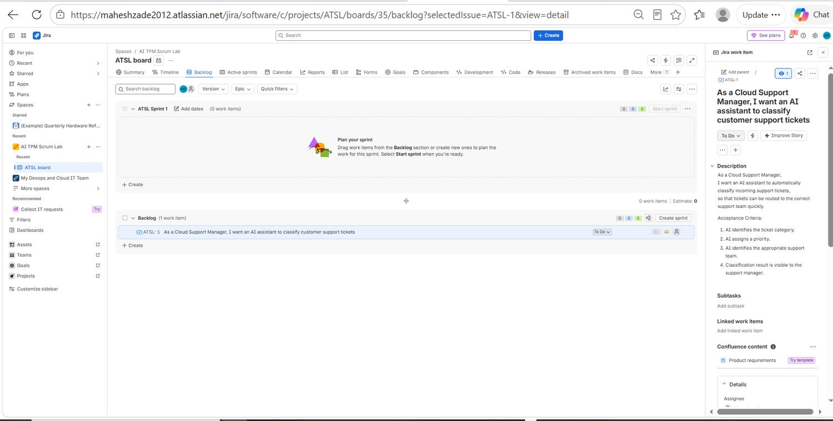
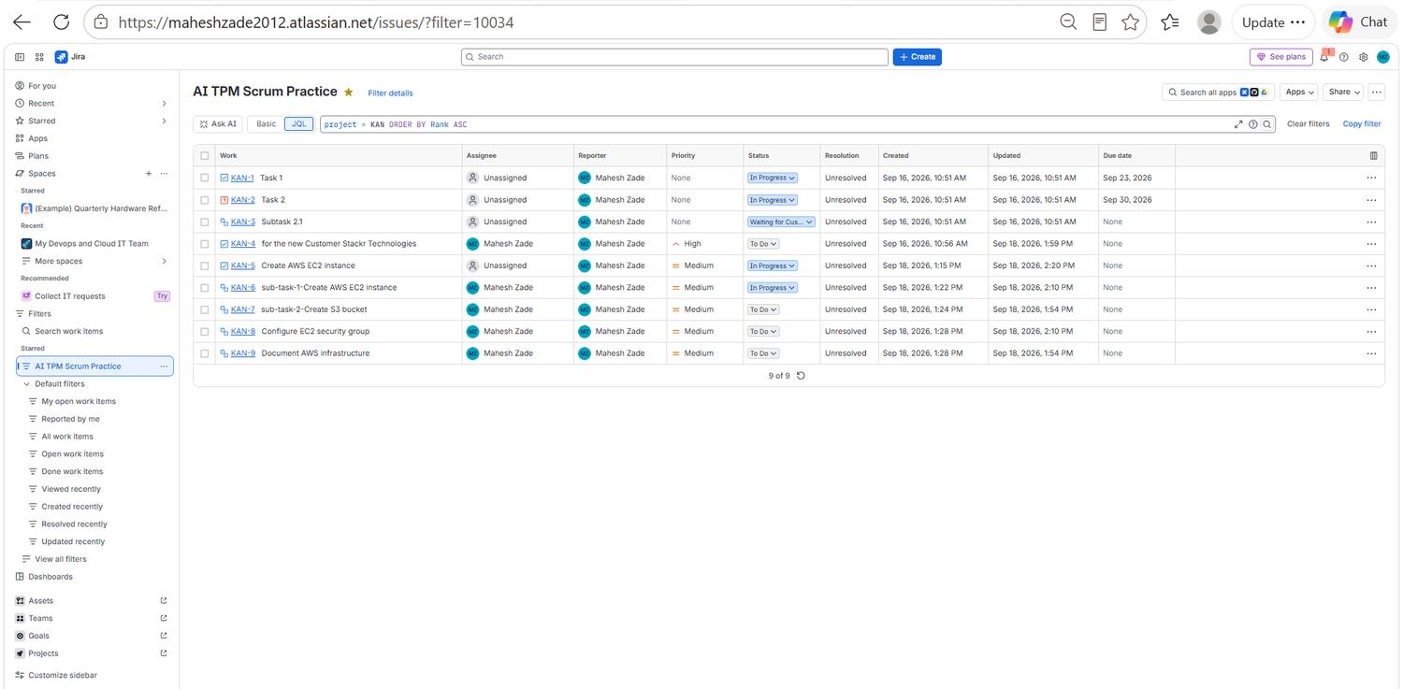
EVIDENCE 12 / 40
AI Scrum Backlog and Planning
EVID-023
First user story created
EVID-024
Saved filter output
ATSL-1 created: 'As a Cloud Support Manager, I want an AI assistant to classify customer support tickets' — written in proper user-story form.
The saved filter 'AI TPM Scrum Practice' returning the KAN work items with their current status, priority and due dates.
Mahesh Zade • AI TPM / Jira Delivery Project
37
Notes:
EVID-023: First user story created. ATSL-1 created: 'As a Cloud Support Manager, I want an AI assistant to classify customer support tickets' — written in proper user-story form. EVID-024: Saved filter output. The saved filter 'AI TPM Scrum Practice' returning the KAN work items with their current status, priority and due dates.

Slide 38
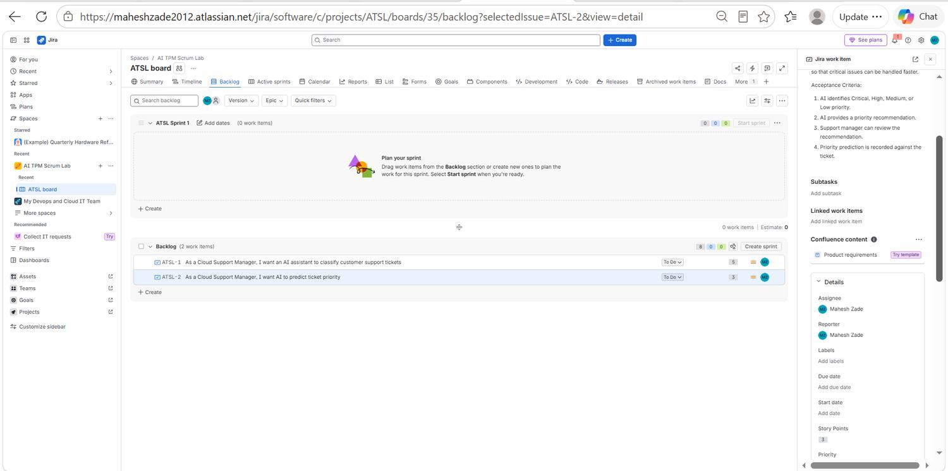
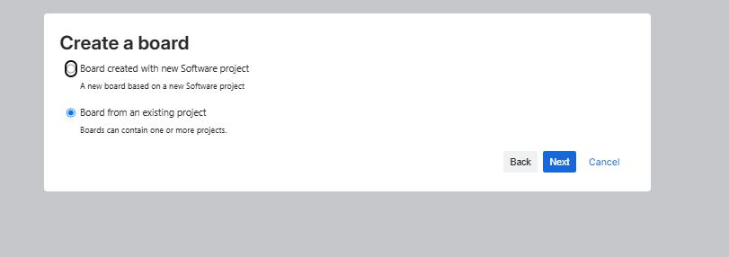
EVIDENCE 13 / 40
AI Scrum Backlog and Planning
EVID-025
Acceptance criteria for ATSL-2
EVID-026
Board from an existing project
ATSL-2 priority-prediction story with acceptance criteria: Critical/High/Medium/Low identification, a recommendation, manager review and a recorded prediction.
The create-a-board dialog with 'Board from an existing project' selected, showing that a board can span one or more projects.
Mahesh Zade • AI TPM / Jira Delivery Project
38
Notes:
EVID-025: Acceptance criteria for ATSL-2. ATSL-2 priority-prediction story with acceptance criteria: Critical/High/Medium/Low identification, a recommendation, manager review and a recorded prediction. EVID-026: Board from an existing project. The create-a-board dialog with 'Board from an existing project' selected, showing that a board can span one or more projects.

Slide 39
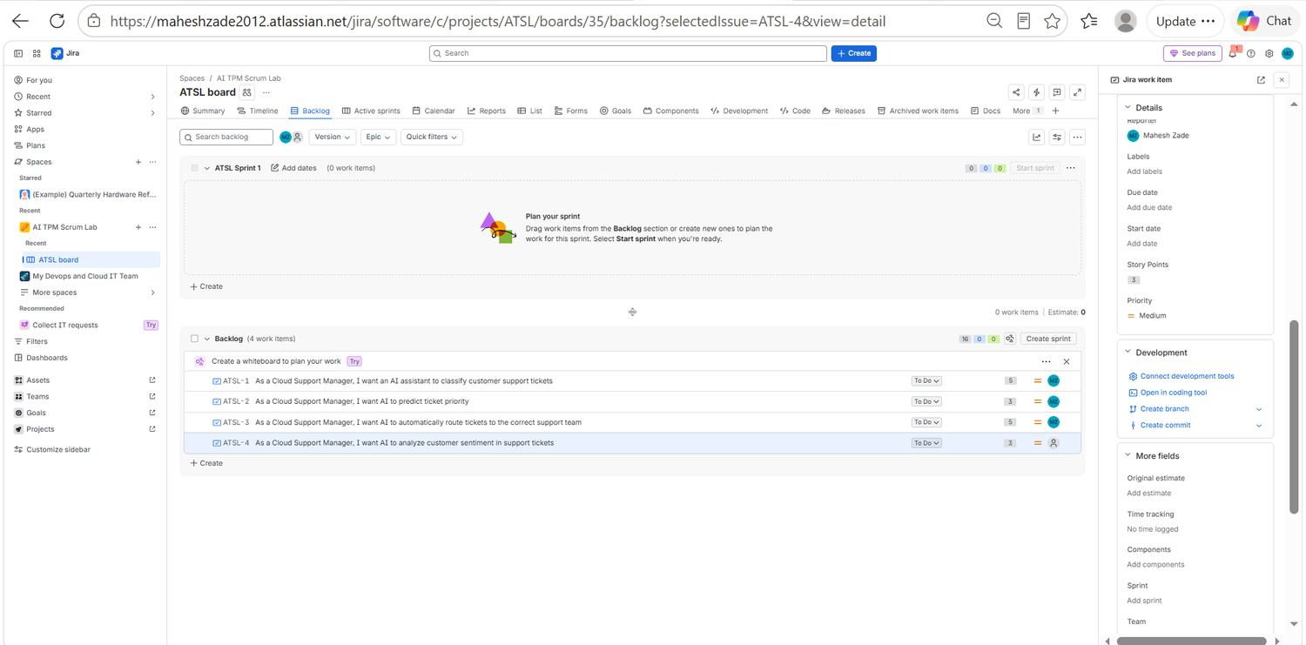
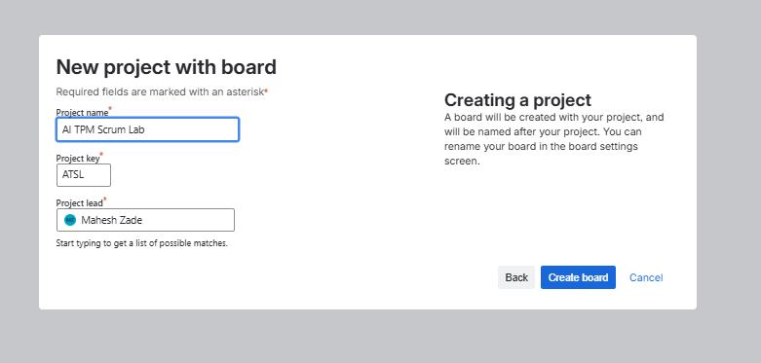
EVIDENCE 14 / 40
AI Scrum Backlog and Planning
EVID-027
Complete AI backlog
EVID-028
Creating the ATSL project
The full AI backlog: ATSL-1 classification, ATSL-2 priority prediction, ATSL-3 routing and ATSL-4 sentiment analysis.
Creating the Scrum project 'AI TPM Scrum Lab' with project key ATSL and Mahesh Zade as project lead.
Mahesh Zade • AI TPM / Jira Delivery Project
39
Notes:
EVID-027: Complete AI backlog. The full AI backlog: ATSL-1 classification, ATSL-2 priority prediction, ATSL-3 routing and ATSL-4 sentiment analysis. EVID-028: Creating the ATSL project. Creating the Scrum project 'AI TPM Scrum Lab' with project key ATSL and Mahesh Zade as project lead.

Slide 40
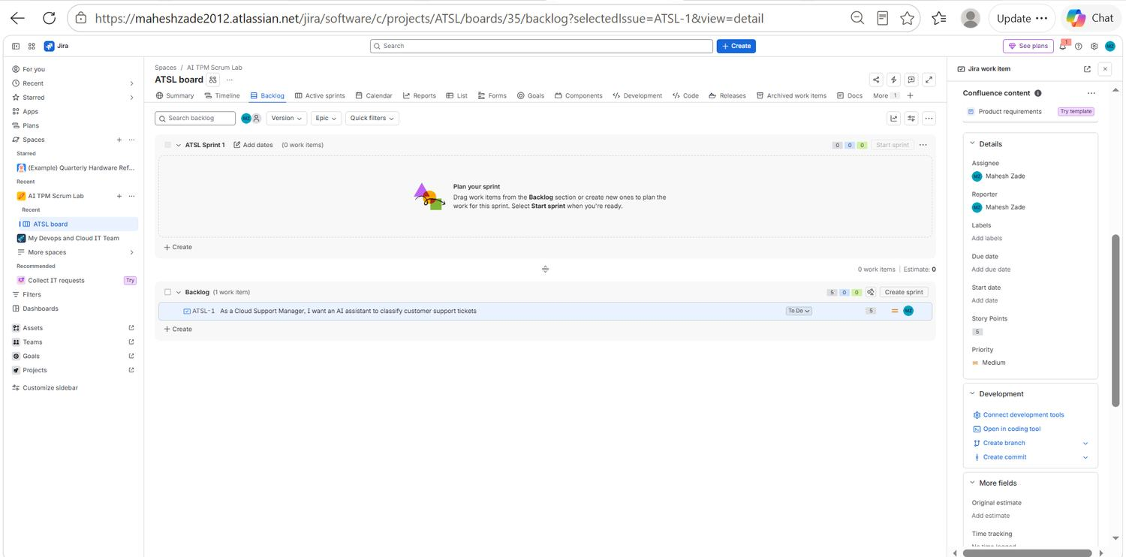
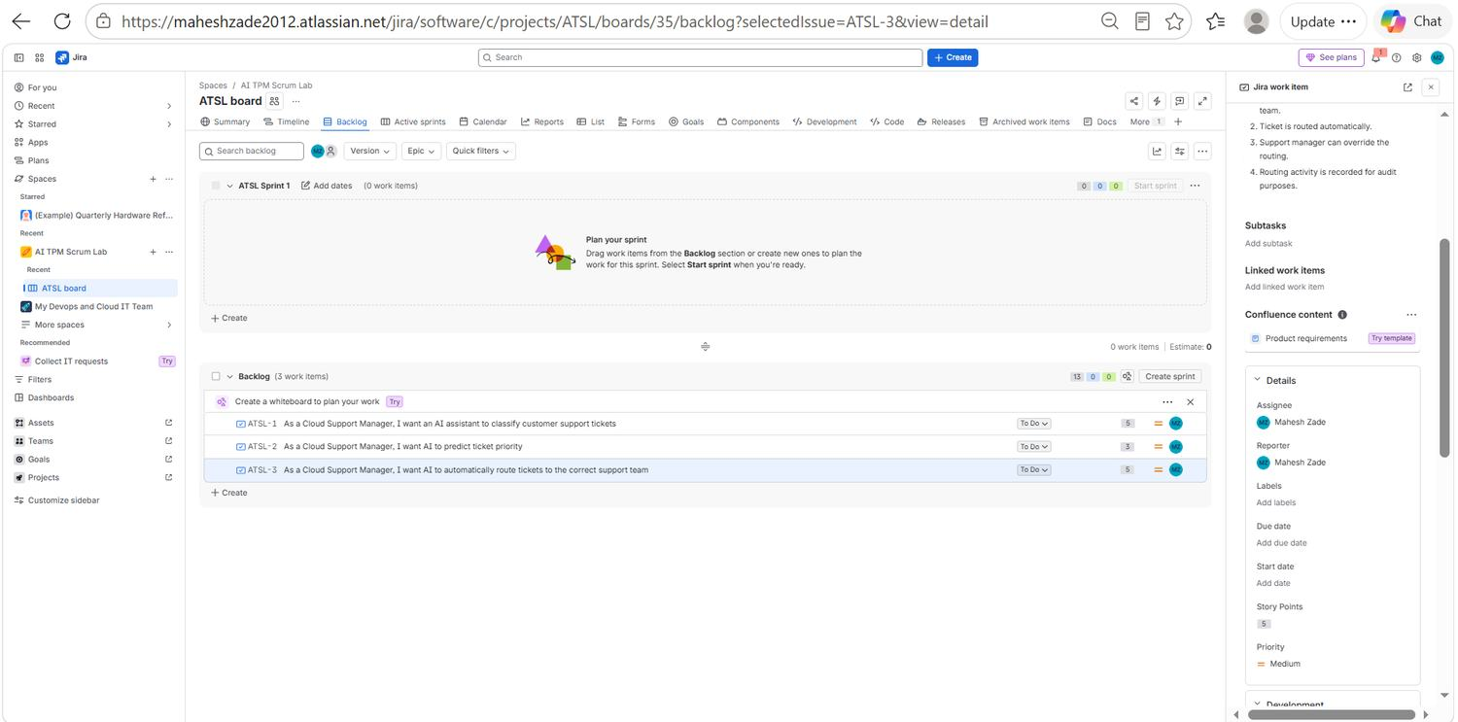
EVIDENCE 15 / 40
AI Scrum Backlog and Planning
EVID-029
Story fields and estimation
EVID-030
Routing story criteria
The story detail panel showing assignee, reporter, story points, priority and start/due date fields available for ATSL-1.
ATSL-3 routing story selected, with acceptance criteria covering automatic routing to the correct team and audit logging of the routing decision.
Mahesh Zade • AI TPM / Jira Delivery Project
40
Notes:
EVID-029: Story fields and estimation. The story detail panel showing assignee, reporter, story points, priority and start/due date fields available for ATSL-1. EVID-030: Routing story criteria. ATSL-3 routing story selected, with acceptance criteria covering automatic routing to the correct team and audit logging of the routing decision.

Slide 41
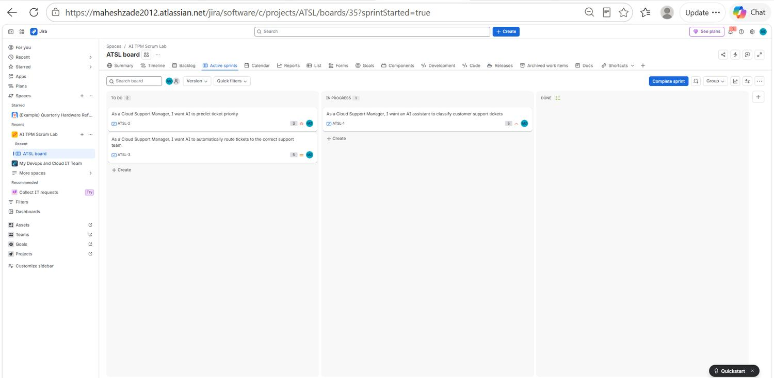
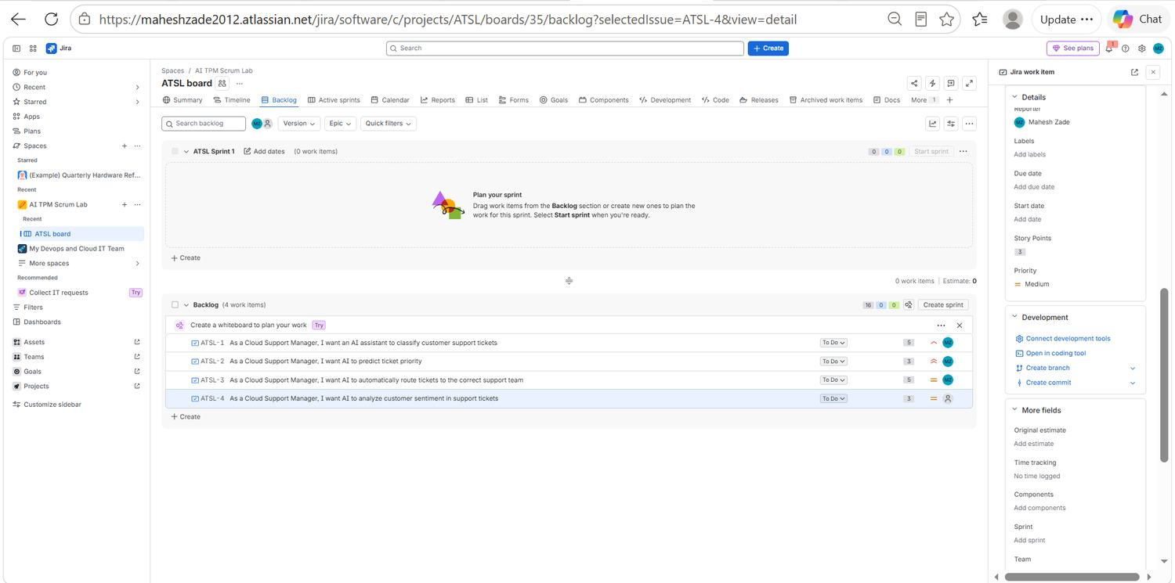
EVIDENCE 16 / 40
AI Scrum Backlog and Planning
EVID-031
Sprint 1 board at start
EVID-032
Sprint scope vs backlog
The active ATSL Sprint 1 board with ATSL-1 in progress and ATSL-2 and ATSL-3 waiting in To Do.
Backlog view with the sprint section populated and ATSL-4 sentiment analysis deliberately held outside the sprint scope.
Mahesh Zade • AI TPM / Jira Delivery Project
41
Notes:
EVID-031: Sprint 1 board at start. The active ATSL Sprint 1 board with ATSL-1 in progress and ATSL-2 and ATSL-3 waiting in To Do. EVID-032: Sprint scope vs backlog. Backlog view with the sprint section populated and ATSL-4 sentiment analysis deliberately held outside the sprint scope.

Slide 42
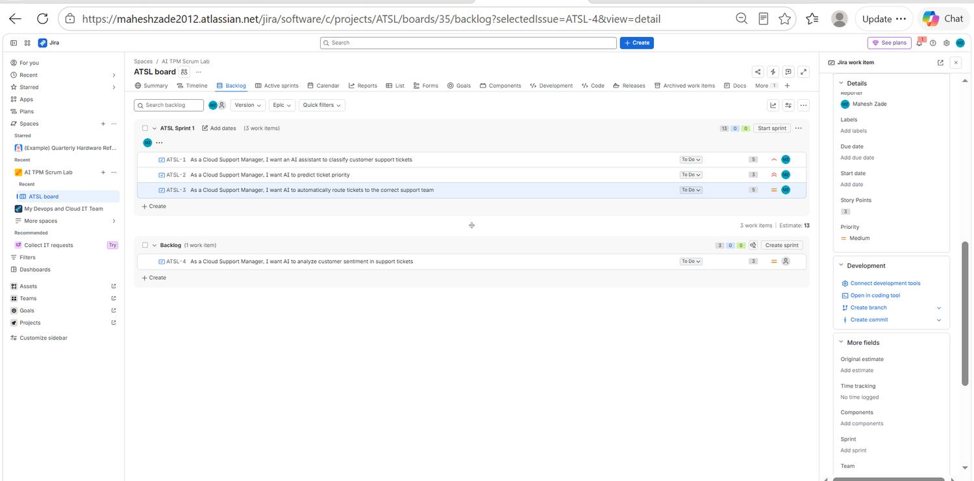
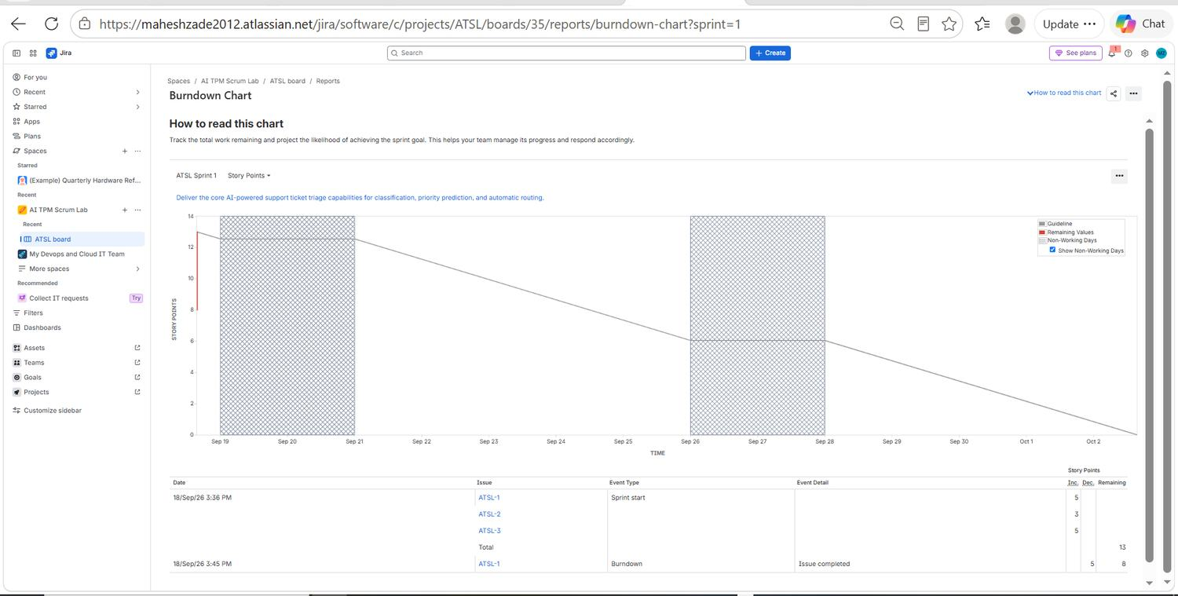
EVIDENCE 17 / 40
AI Scrum Backlog and Planning
EVID-033
Committed sprint scope
EVID-034
Sprint burndown chart
Sprint 1 scope confirmed: three stories committed to ATSL Sprint 1, with sentiment analysis left in the backlog for a later sprint.
The ATSL Sprint 1 burndown with the ideal guideline against remaining values, plus the event table recording the sprint start and completion of ATSL-1.
Mahesh Zade • AI TPM / Jira Delivery Project
42
Notes:
EVID-033: Committed sprint scope. Sprint 1 scope confirmed: three stories committed to ATSL Sprint 1, with sentiment analysis left in the backlog for a later sprint. EVID-034: Sprint burndown chart. The ATSL Sprint 1 burndown with the ideal guideline against remaining values, plus the event table recording the sprint start and completion of ATSL-1.

Slide 43
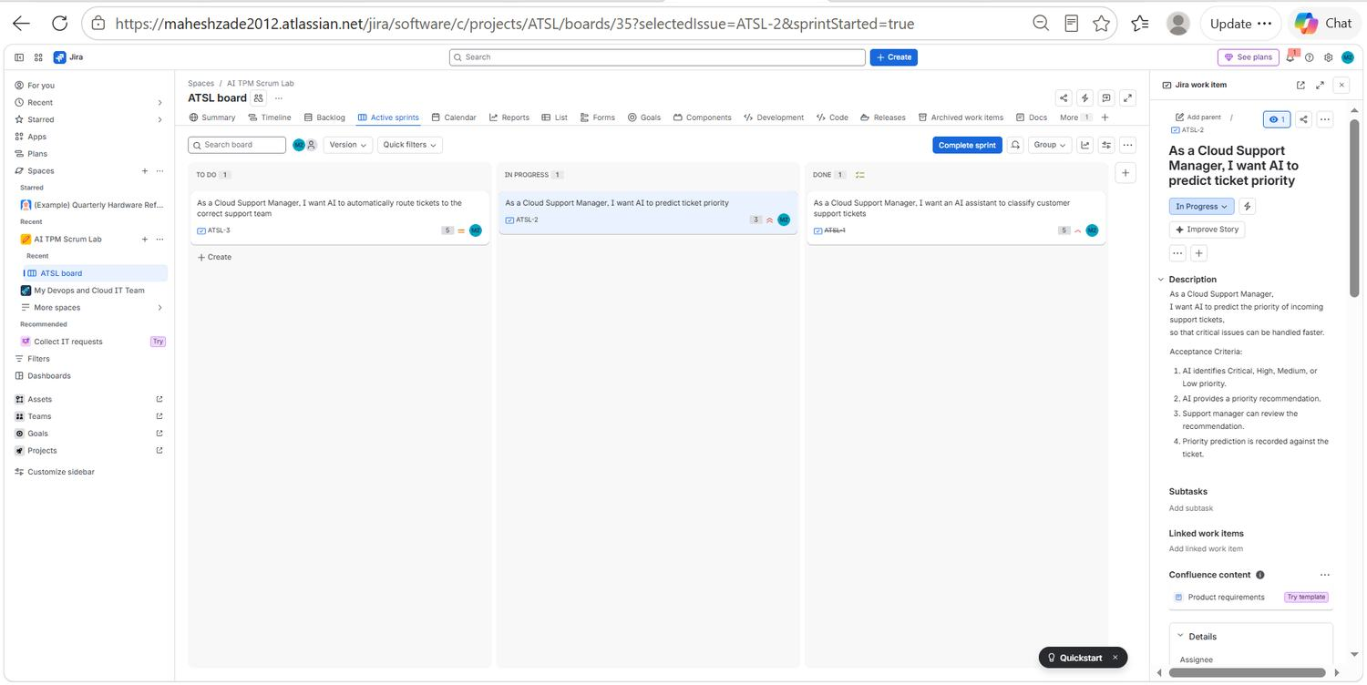
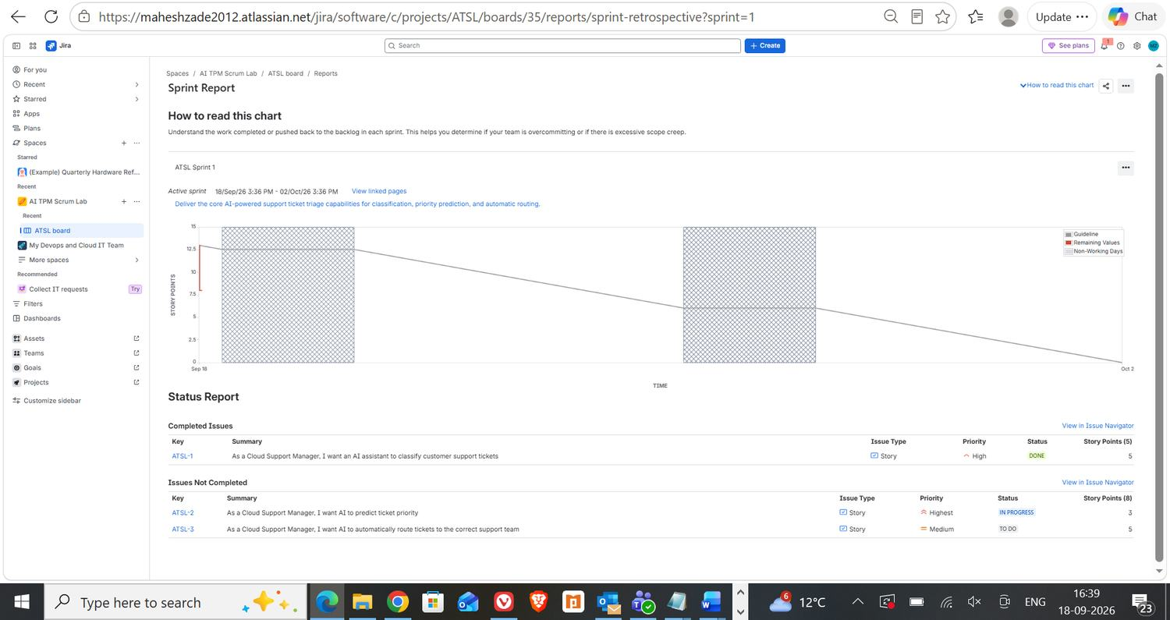
EVIDENCE 18 / 40
Sprint Execution and Reporting
EVID-035
ATSL-2 moved to In Progress
EVID-036
Sprint report
ATSL-2 moved into the In Progress column on the sprint board, with its full acceptance criteria visible in the detail panel.
The Sprint Report separating completed work (ATSL-1, Done, 5 points) from work not completed (ATSL-2 In Progress and ATSL-3 To Do).
Mahesh Zade • AI TPM / Jira Delivery Project
43
Notes:
EVID-035: ATSL-2 moved to In Progress. ATSL-2 moved into the In Progress column on the sprint board, with its full acceptance criteria visible in the detail panel. EVID-036: Sprint report. The Sprint Report separating completed work (ATSL-1, Done, 5 points) from work not completed (ATSL-2 In Progress and ATSL-3 To Do).

Slide 44
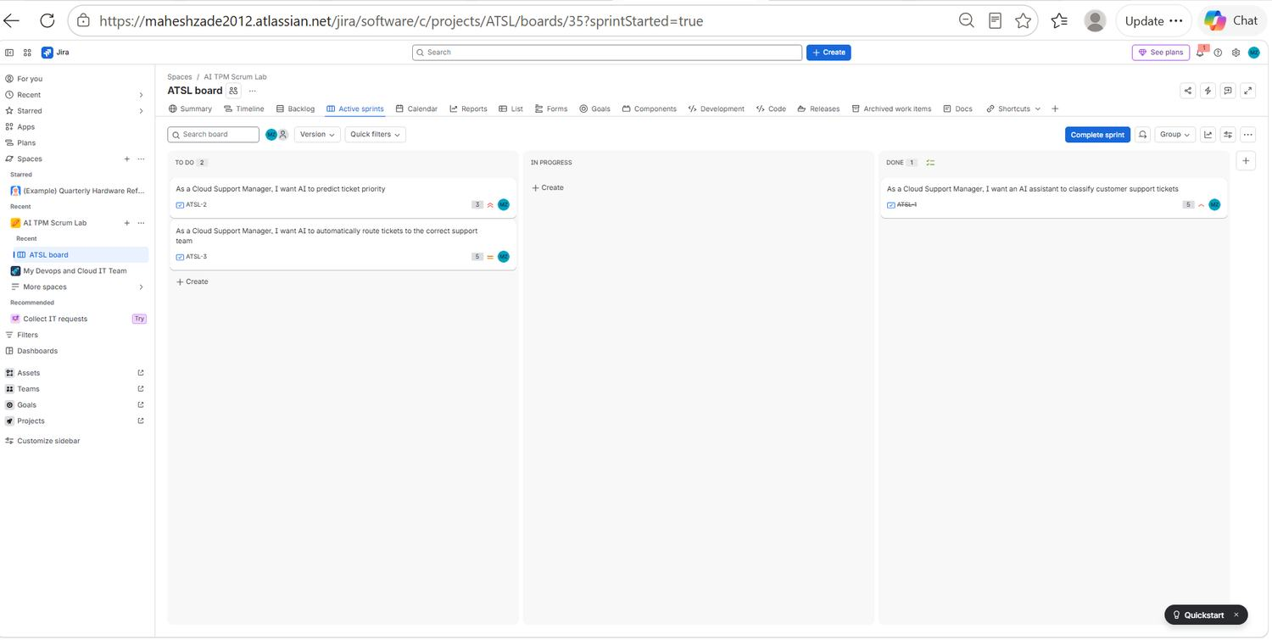
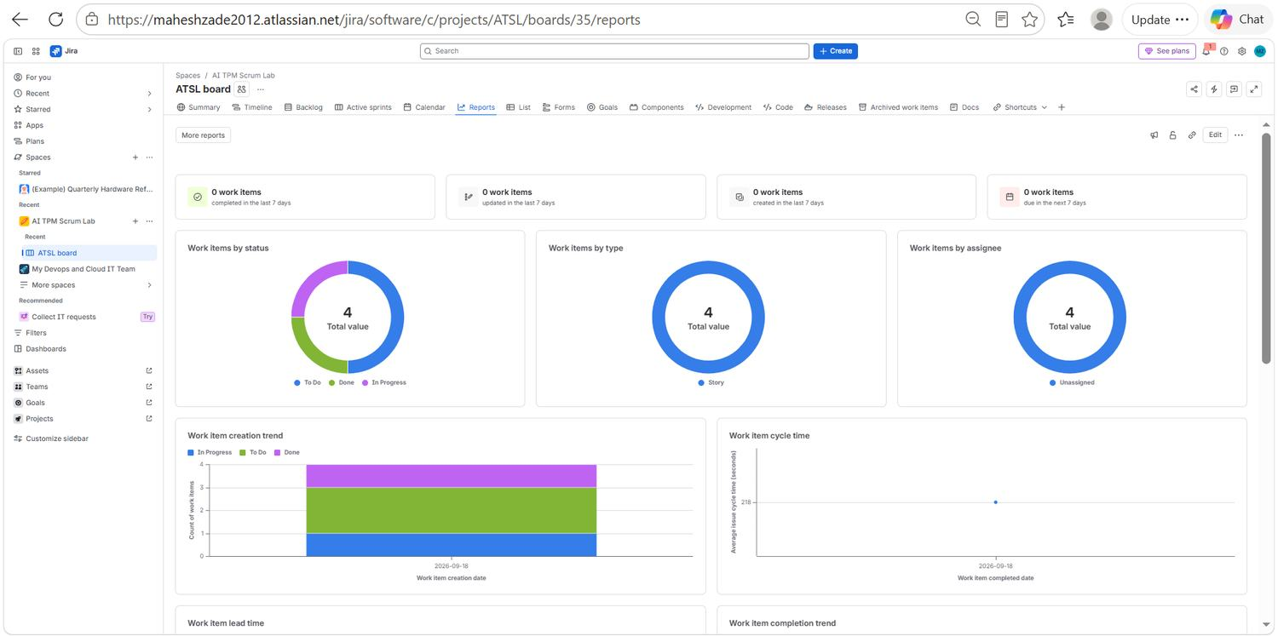
EVIDENCE 19 / 40
Sprint Execution and Reporting
EVID-037
First story delivered
EVID-038
Project reports overview
Sprint board with ATSL-1 in the Done column while the remaining two committed stories are still open.
The reports overview page: work items by status, by type and by assignee, plus the creation-trend and cycle-time charts.
Mahesh Zade • AI TPM / Jira Delivery Project
44
Notes:
EVID-037: First story delivered. Sprint board with ATSL-1 in the Done column while the remaining two committed stories are still open. EVID-038: Project reports overview. The reports overview page: work items by status, by type and by assignee, plus the creation-trend and cycle-time charts.

Slide 45
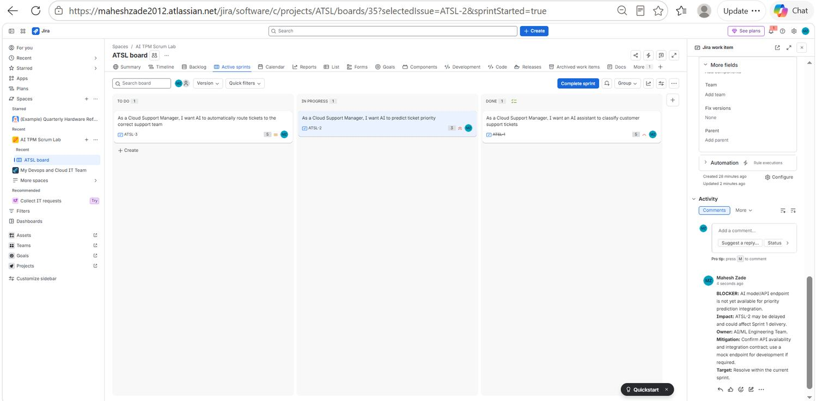
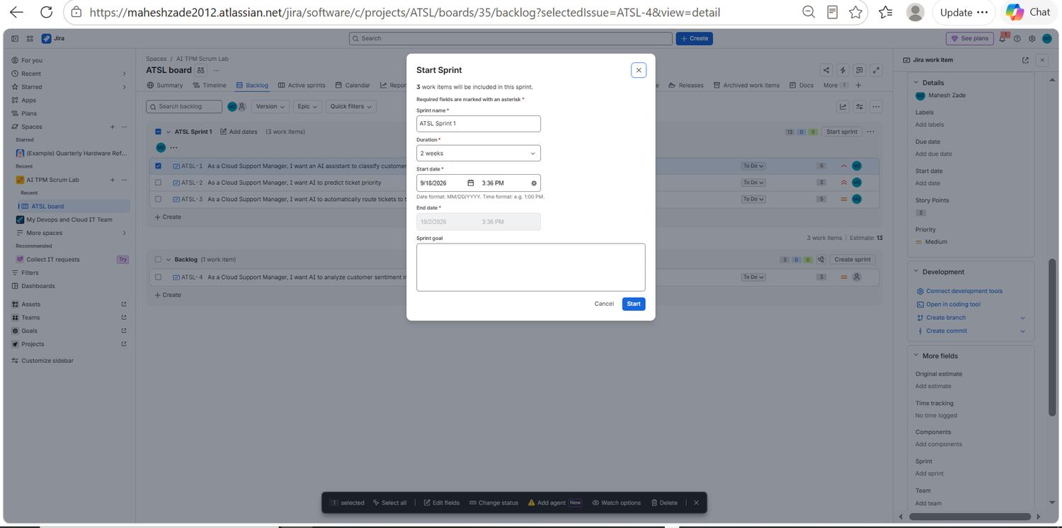
EVIDENCE 20 / 40
Sprint Execution and Reporting
EVID-039
Structured blocker comment
EVID-040
Starting the sprint
A TPM blocker comment on ATSL-2 recording BLOCKER, Impact, Owner, Mitigation and Target — a status update with a decision attached, not a note.
The Start Sprint dialog: ATSL Sprint 1, a two-week duration, explicit start and end dates and a sprint-goal field.
Mahesh Zade • AI TPM / Jira Delivery Project
45
Notes:
EVID-039: Structured blocker comment. A TPM blocker comment on ATSL-2 recording BLOCKER, Impact, Owner, Mitigation and Target — a status update with a decision attached, not a note. EVID-040: Starting the sprint. The Start Sprint dialog: ATSL Sprint 1, a two-week duration, explicit start and end dates and a sprint-goal field.

Slide 46
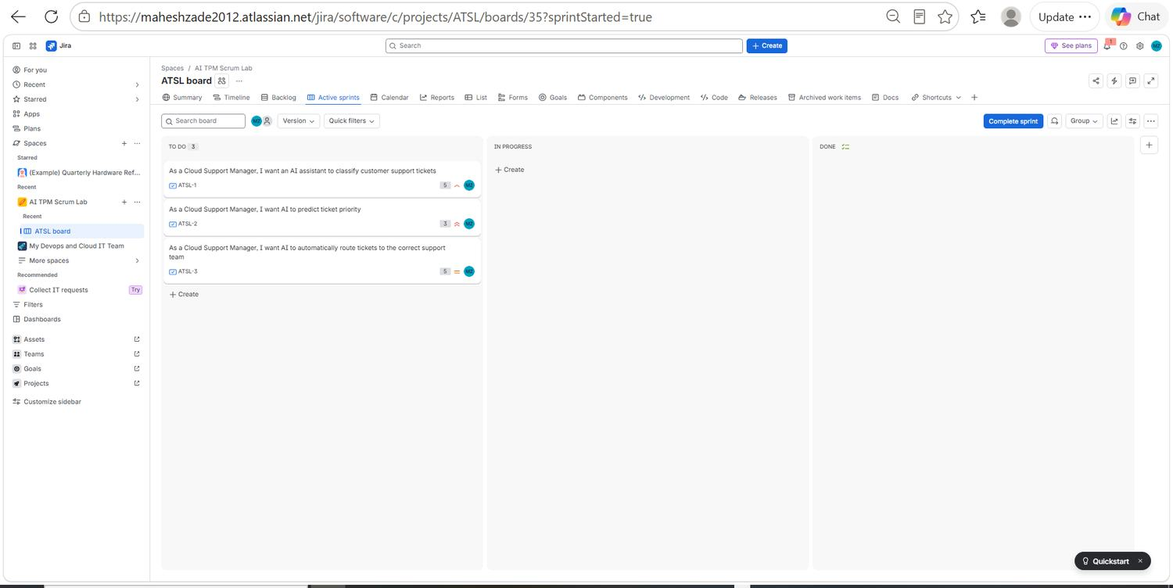
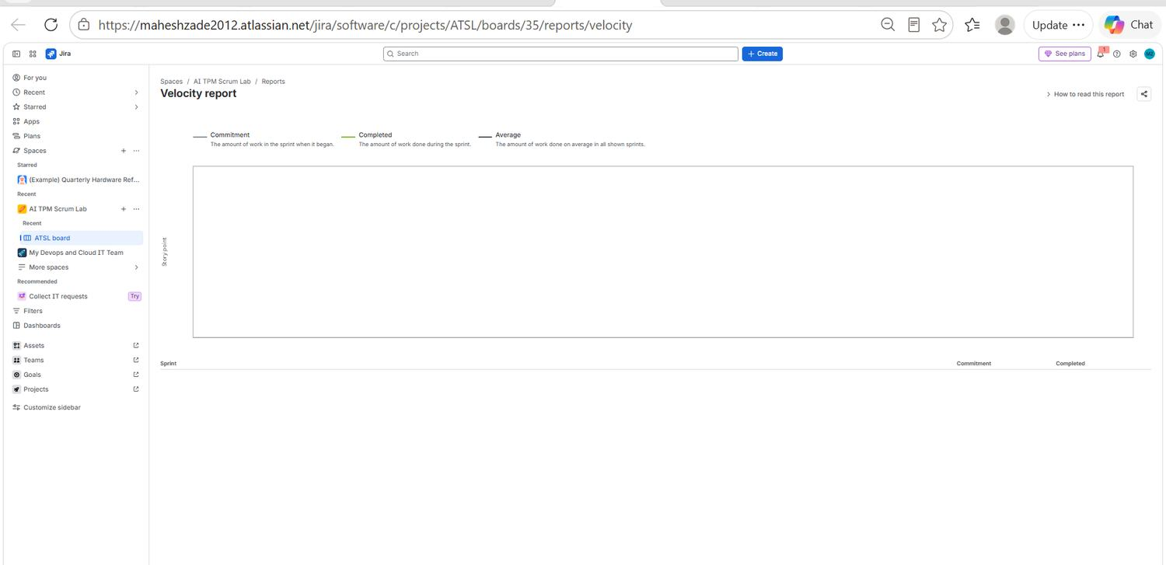
EVIDENCE 21 / 40
Sprint Execution and Reporting
EVID-041
Sprint day one
EVID-042
Velocity report
The sprint board immediately after start, with all three committed stories sitting in To Do and nothing yet in flight.
The velocity report comparing commitment against completed work; it stays empty until the first sprint is formally closed.
Mahesh Zade • AI TPM / Jira Delivery Project
46
Notes:
EVID-041: Sprint day one. The sprint board immediately after start, with all three committed stories sitting in To Do and nothing yet in flight. EVID-042: Velocity report. The velocity report comparing commitment against completed work; it stays empty until the first sprint is formally closed.

Slide 47
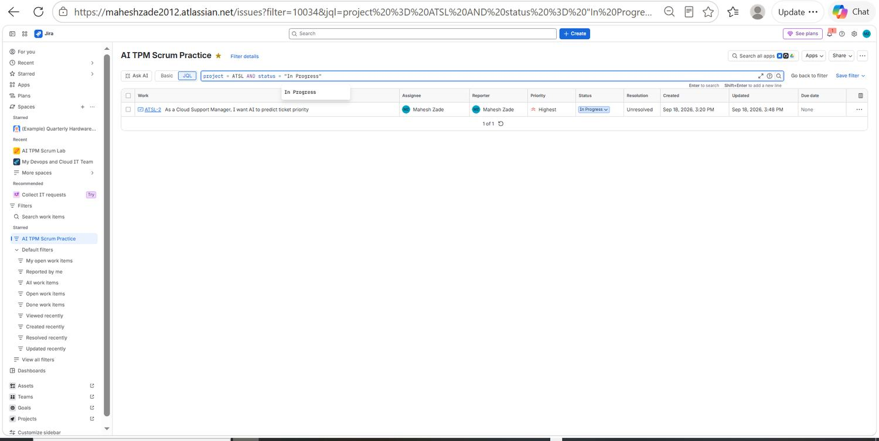
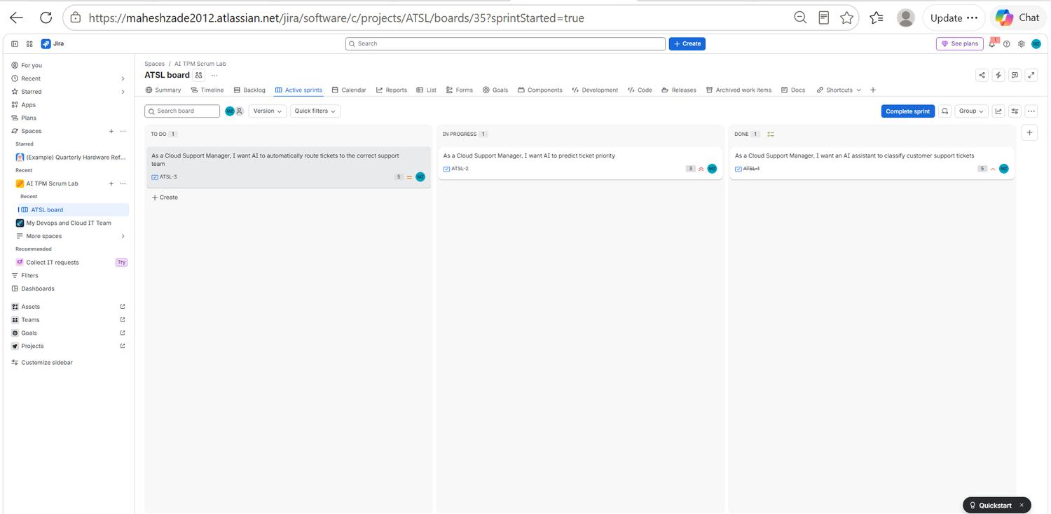
EVIDENCE 22 / 40
Sprint Execution and Reporting
EVID-043
In-progress query
EVID-044
Mid-sprint flow
JQL project = ATSL AND status = "In Progress" returning ATSL-2 as the single actively worked story.
A mid-sprint flow snapshot with exactly one story in each of To Do, In Progress and Done — healthy, limited work in progress.
Mahesh Zade • AI TPM / Jira Delivery Project
47
Notes:
EVID-043: In-progress query. JQL project = ATSL AND status = "In Progress" returning ATSL-2 as the single actively worked story. EVID-044: Mid-sprint flow. A mid-sprint flow snapshot with exactly one story in each of To Do, In Progress and Done — healthy, limited work in progress.

Slide 48
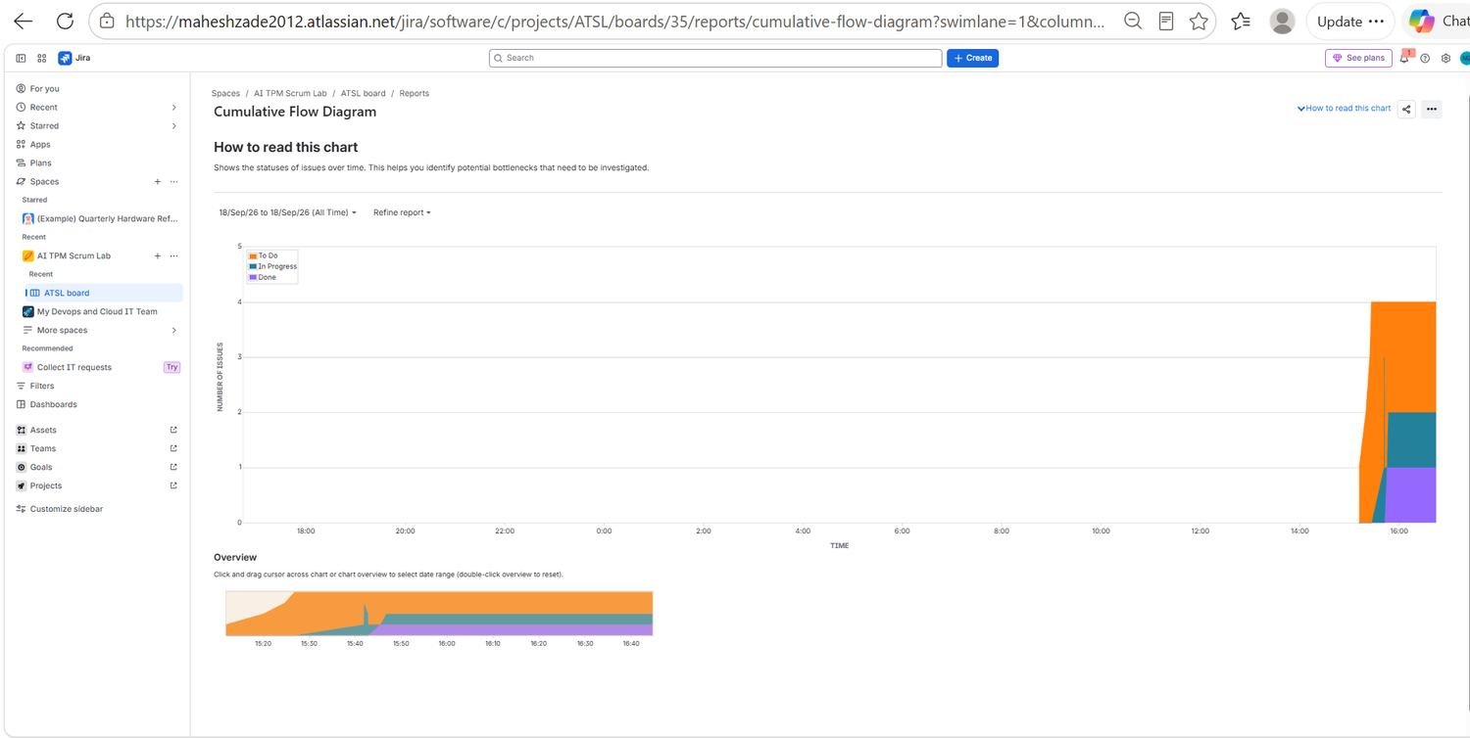
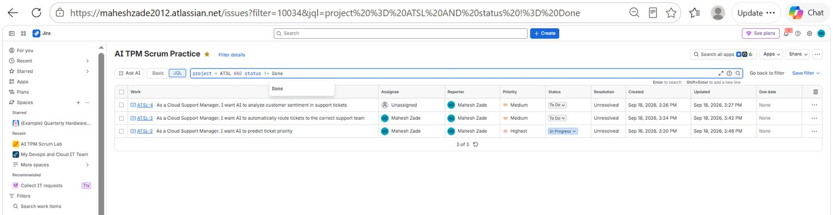
EVIDENCE 23 / 40
Sprint Execution and Reporting
EVID-045
Cumulative flow diagram
EVID-046
Outstanding work query
The Cumulative Flow Diagram showing how the To Do, In Progress and Done bands accumulate across the sprint timeline.
JQL project = ATSL AND status != Done listing the three stories that remain unresolved.
Mahesh Zade • AI TPM / Jira Delivery Project
48
Notes:
EVID-045: Cumulative flow diagram. The Cumulative Flow Diagram showing how the To Do, In Progress and Done bands accumulate across the sprint timeline. EVID-046: Outstanding work query. JQL project = ATSL AND status != Done listing the three stories that remain unresolved.

Slide 49
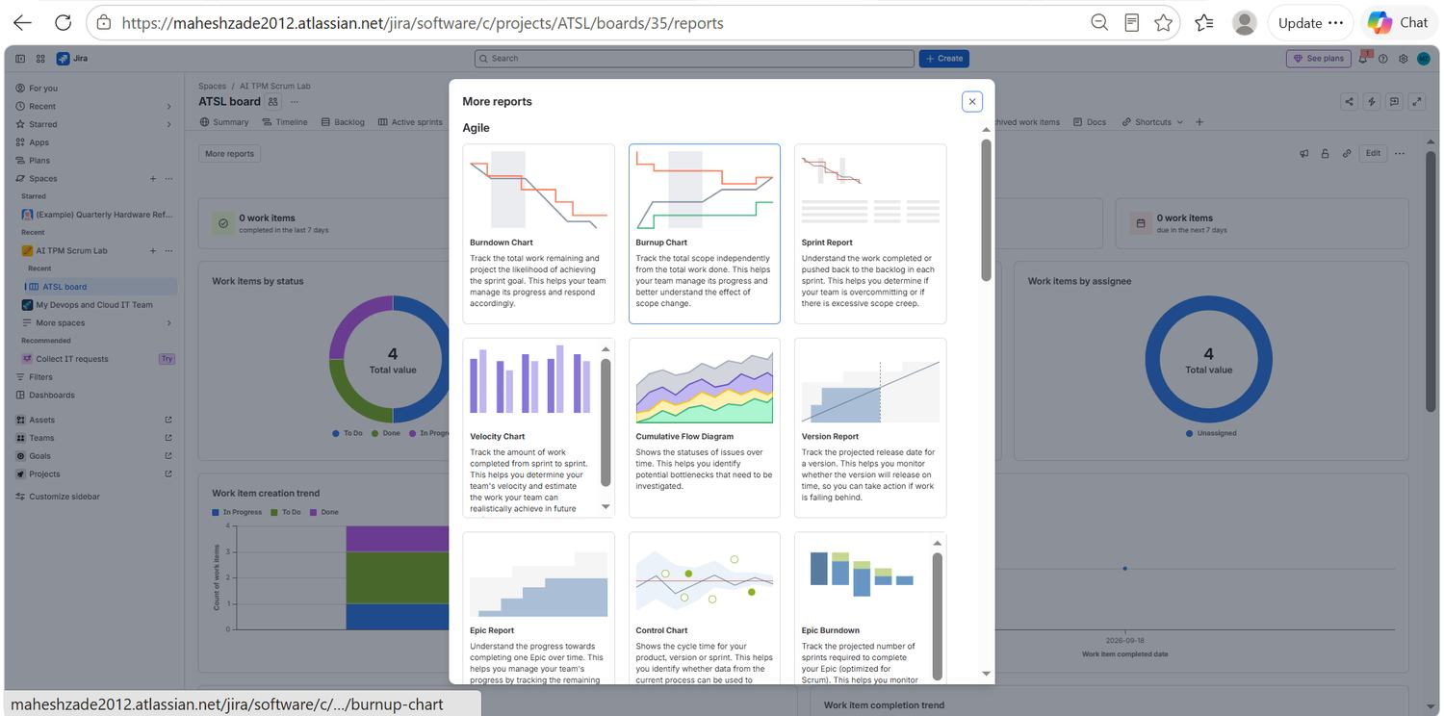
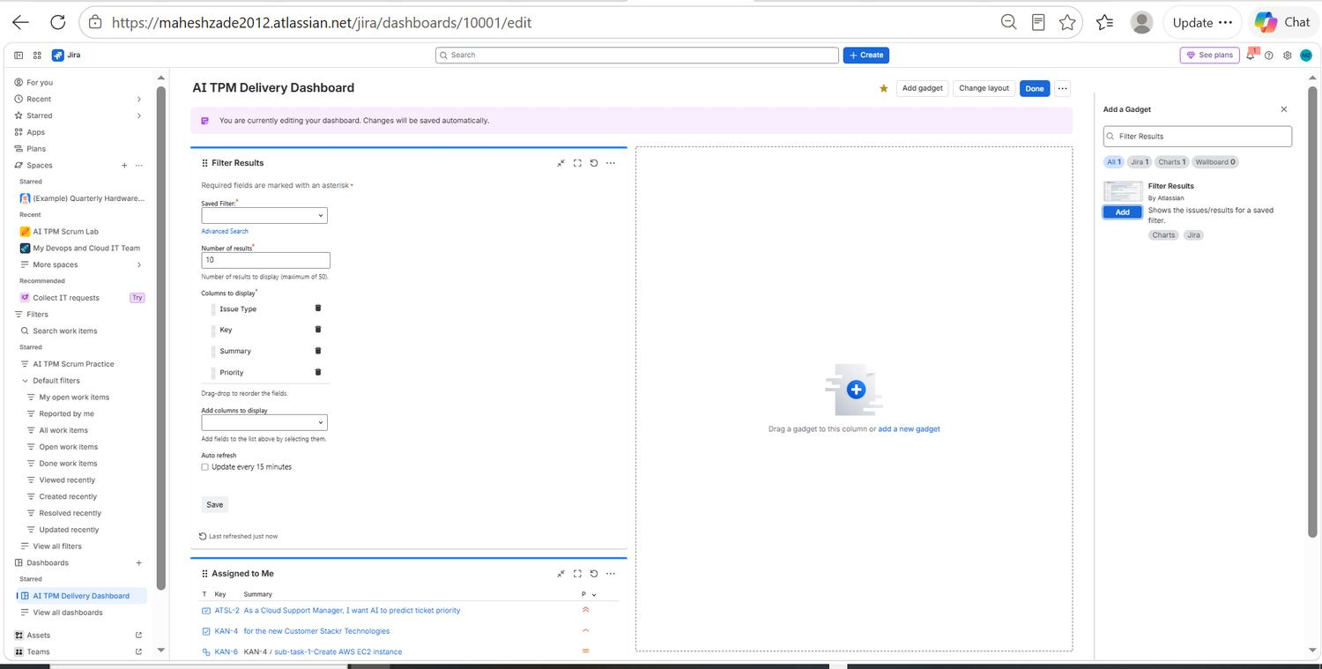
EVIDENCE 24 / 40
Sprint Execution and Reporting
EVID-047
Available Jira reports
EVID-048
Dashboard edit mode
Jira's report gallery — Burndown, Burnup, Sprint Report, Velocity, Cumulative Flow, Version, Epic and Control charts.
The AI TPM Delivery Dashboard in edit mode, with a Filter Results gadget being pointed at a saved filter.
Mahesh Zade • AI TPM / Jira Delivery Project
49
Notes:
EVID-047: Available Jira reports. Jira's report gallery — Burndown, Burnup, Sprint Report, Velocity, Cumulative Flow, Version, Epic and Control charts. EVID-048: Dashboard edit mode. The AI TPM Delivery Dashboard in edit mode, with a Filter Results gadget being pointed at a saved filter.

Slide 50
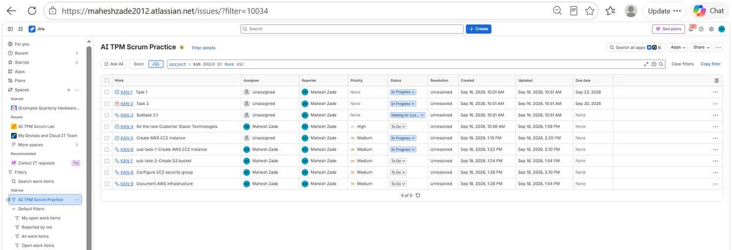

EVIDENCE 25 / 40
JQL, Filters and Dashboard Build
EVID-049
Filter results listing
EVID-050
All ATSL work
Saved filter output listing all nine KAN items with status, priority, resolution and timestamps.
JQL project = ATSL returning all four AI stories together with their priority and current status.
Mahesh Zade • AI TPM / Jira Delivery Project
50
Notes:
EVID-049: Filter results listing. Saved filter output listing all nine KAN items with status, priority, resolution and timestamps. EVID-050: All ATSL work. JQL project = ATSL returning all four AI stories together with their priority and current status.

Slide 51


EVIDENCE 26 / 40
JQL, Filters and Dashboard Build
EVID-051
ATSL list detail
EVID-052
High-priority query
Full-width view of the ATSL work list, confirming assignee, reporter and status for each of the four stories.
JQL project = ATSL AND priority in (Highest, High) isolating the two items that carry the highest delivery priority.
Mahesh Zade • AI TPM / Jira Delivery Project
51
Notes:
EVID-051: ATSL list detail. Full-width view of the ATSL work list, confirming assignee, reporter and status for each of the four stories. EVID-052: High-priority query. JQL project = ATSL AND priority in (Highest, High) isolating the two items that carry the highest delivery priority.

Slide 52


EVIDENCE 27 / 40
JQL, Filters and Dashboard Build
EVID-053
Gadget catalogue
EVID-054
Assigned to Me gadget
The Add a gadget panel listing the Jira dashboard gadgets available, from Activity Stream through to chart gadgets.
The 'Assigned to Me' gadget added to the dashboard, showing the nine work items personally owned by Mahesh Zade.
Mahesh Zade • AI TPM / Jira Delivery Project
52
Notes:
EVID-053: Gadget catalogue. The Add a gadget panel listing the Jira dashboard gadgets available, from Activity Stream through to chart gadgets. EVID-054: Assigned to Me gadget. The 'Assigned to Me' gadget added to the dashboard, showing the nine work items personally owned by Mahesh Zade.

Slide 53


EVIDENCE 28 / 40
JQL, Filters and Dashboard Build
EVID-055
Dashboards before setup
EVID-056
Finding Filter Results
The Jira Dashboards page showing only the default dashboard, before the TPM delivery dashboard was created.
Searching the gadget catalogue for the Filter Results gadget, which turns any saved filter into a dashboard view.
Mahesh Zade • AI TPM / Jira Delivery Project
53
Notes:
EVID-055: Dashboards before setup. The Jira Dashboards page showing only the default dashboard, before the TPM delivery dashboard was created. EVID-056: Finding Filter Results. Searching the gadget catalogue for the Filter Results gadget, which turns any saved filter into a dashboard view.

Slide 54


EVIDENCE 29 / 40
JQL, Filters and Dashboard Build
EVID-057
Creating the dashboard
EVID-058
Blocked work query
The Create dashboard dialog where the AI TPM Delivery Dashboard was named and its viewer and editor permissions set.
JQL project = KAN AND workItemLinkType = "is blocked by" returning KAN-8, the blocked security-group task.
Mahesh Zade • AI TPM / Jira Delivery Project
54
Notes:
EVID-057: Creating the dashboard. The Create dashboard dialog where the AI TPM Delivery Dashboard was named and its viewer and editor permissions set. EVID-058: Blocked work query. JQL project = KAN AND workItemLinkType = "is blocked by" returning KAN-8, the blocked security-group task.

Slide 55


EVIDENCE 30 / 40
JQL, Filters and Dashboard Build
EVID-059
Negative result is evidence
EVID-060
Personal workload query
The same blocked-by query run against ATSL returns no rows, confirming that this particular dependency lives in the KAN project.
JQL project = ATSL AND assignee = currentUser() returning the three stories owned directly by the TPM.
Mahesh Zade • AI TPM / Jira Delivery Project
55
Notes:
EVID-059: Negative result is evidence. The same blocked-by query run against ATSL returns no rows, confirming that this particular dependency lives in the KAN project. EVID-060: Personal workload query. JQL project = ATSL AND assignee = currentUser() returning the three stories owned directly by the TPM.

Slide 56


EVIDENCE 31 / 40
JQL, Filters and Dashboard Build
EVID-061
Master work list
EVID-062
Binding gadget to filter
All 28 work items across both projects, ordered by creation date — the master list behind the whole evidence package.
The Filter Results gadget bound to the saved 'AI TPM Scrum Practice' filter, with Issue Type, Key, Summary and Priority selected as columns.
Mahesh Zade • AI TPM / Jira Delivery Project
56
Notes:
EVID-061: Master work list. All 28 work items across both projects, ordered by creation date — the master list behind the whole evidence package. EVID-062: Binding gadget to filter. The Filter Results gadget bound to the saved 'AI TPM Scrum Practice' filter, with Issue Type, Key, Summary and Priority selected as columns.

Slide 57


EVIDENCE 32 / 40
JQL, Filters and Dashboard Build
EVID-063
Two gadgets live
EVID-064
Blocker re-confirmed
The dashboard with Filter Results and Assigned to Me both rendering live Jira data side by side.
The blocked-by query re-run and confirmed: KAN-8 Configure EC2 security group is the single blocked item in the programme.
Mahesh Zade • AI TPM / Jira Delivery Project
57
Notes:
EVID-063: Two gadgets live. The dashboard with Filter Results and Assigned to Me both rendering live Jira data side by side. EVID-064: Blocker re-confirmed. The blocked-by query re-run and confirmed: KAN-8 Configure EC2 security group is the single blocked item in the programme.

Slide 58


EVIDENCE 33 / 40
JQL, Filters and Dashboard Build
EVID-065
Gadget configuration
EVID-066
Blocker from All Work
Assigned to Me gadget configuration — result count and the Issue Type, Key, Summary and Priority columns to display.
The same blocker surfaced from the cross-project All Work view, showing the query works outside a single board context.
Mahesh Zade • AI TPM / Jira Delivery Project
58
Notes:
EVID-065: Gadget configuration. Assigned to Me gadget configuration — result count and the Issue Type, Key, Summary and Priority columns to display. EVID-066: Blocker from All Work. The same blocker surfaced from the cross-project All Work view, showing the query works outside a single board context.

Slide 59


EVIDENCE 34 / 40
JQL, Filters and Dashboard Build
EVID-067
TPM - KAN Blockers filter
EVID-068
Blockers on the dashboard
The saved filter 'TPM - KAN Blockers' returning KAN-8 — a reusable dependency view rather than a one-off search.
The Filter Results gadget re-pointed at the TPM - KAN Blockers filter so blocked work appears on the dashboard automatically.
Mahesh Zade • AI TPM / Jira Delivery Project
59
Notes:
EVID-067: TPM - KAN Blockers filter. The saved filter 'TPM - KAN Blockers' returning KAN-8 — a reusable dependency view rather than a one-off search. EVID-068: Blockers on the dashboard. The Filter Results gadget re-pointed at the TPM - KAN Blockers filter so blocked work appears on the dashboard automatically.

Slide 60


EVIDENCE 35 / 40
JQL, Filters and Dashboard Build
EVID-069
Saving the blockers filter
EVID-070
Gadget maintenance menu
Saving the blocked-by query under the name 'TPM - KAN Blockers' so it can feed both the dashboard and stakeholder reviews.
The gadget menu offering refresh, rename, copy, configure, move and delete — the controls used to keep the dashboard clean.
Mahesh Zade • AI TPM / Jira Delivery Project
60
Notes:
EVID-069: Saving the blockers filter. Saving the blocked-by query under the name 'TPM - KAN Blockers' so it can feed both the dashboard and stakeholder reviews. EVID-070: Gadget maintenance menu. The gadget menu offering refresh, rename, copy, configure, move and delete — the controls used to keep the dashboard clean.

Slide 61


EVIDENCE 36 / 40
JQL, Filters and Dashboard Build
EVID-071
Dashboard layout
EVID-072
Blocked and assigned views
Dashboard layout with the filter and assignment gadgets stacked in the left column, leaving space for the status chart.
TPM - KAN Blockers and Assigned to Me shown together, giving a single answer to 'what is blocked and who owns it'.
Mahesh Zade • AI TPM / Jira Delivery Project
61
Notes:
EVID-071: Dashboard layout. Dashboard layout with the filter and assignment gadgets stacked in the left column, leaving space for the status chart. EVID-072: Blocked and assigned views. TPM - KAN Blockers and Assigned to Me shown together, giving a single answer to 'what is blocked and who owns it'.

Slide 62


EVIDENCE 37 / 40
JQL, Filters and Dashboard Build
EVID-073
Pie chart gadget setup
EVID-074
Reviewing gadget settings
Pie Chart gadget configuration: the source project or saved filter, plus the statistic type that determines what the chart measures.
Filter Results gadget configuration reviewed and saved before the dashboard was published to stakeholders.
Mahesh Zade • AI TPM / Jira Delivery Project
62
Notes:
EVID-073: Pie chart gadget setup. Pie Chart gadget configuration: the source project or saved filter, plus the statistic type that determines what the chart measures. EVID-074: Reviewing gadget settings. Filter Results gadget configuration reviewed and saved before the dashboard was published to stakeholders.

Slide 63


EVIDENCE 38 / 40
JQL, Filters and Dashboard Build
EVID-075
Stakeholder read view
EVID-076
Gadget highlight colours
The dashboard in read mode — how a stakeholder sees it, with no configuration controls in the way.
Gadget highlight colour options used to visually separate risk, blocker and workload sections of the dashboard.
Mahesh Zade • AI TPM / Jira Delivery Project
63
Notes:
EVID-075: Stakeholder read view. The dashboard in read mode — how a stakeholder sees it, with no configuration controls in the way. EVID-076: Gadget highlight colours. Gadget highlight colour options used to visually separate risk, blocker and workload sections of the dashboard.

Slide 64


EVIDENCE 39 / 40
JQL, Filters and Dashboard Build
EVID-077
Adding the status chart
EVID-078
Chart source not yet set
Searching for the Pie Chart gadget to add a status distribution view to the delivery dashboard.
The Pie Chart gadget before a project or saved filter is chosen — the chart cannot render without a data source.
Mahesh Zade • AI TPM / Jira Delivery Project
64
Notes:
EVID-077: Adding the status chart. Searching for the Pie Chart gadget to add a status distribution view to the delivery dashboard. EVID-078: Chart source not yet set. The Pie Chart gadget before a project or saved filter is chosen — the chart cannot render without a data source.

Slide 65

EVIDENCE 40 / 40
Final Delivery Dashboard
EVID-079
Statistic type set to Status
EVID-080
Final AI TPM Delivery Dashboard
Pie Chart statistic type switched to Status so the chart reports delivery state rather than assignee distribution.
The completed dashboard: Status pie chart (10 items — 5 To Do, 3 In Progress, 2 Done), TPM - High Priority Open Work and TPM - AI Risks both surfacing risk ATSL-5, and Assigned to Me.
Mahesh Zade • AI TPM / Jira Delivery Project
65
Notes:
EVID-079: Statistic type set to Status. Pie Chart statistic type switched to Status so the chart reports delivery state rather than assignee distribution. EVID-080: Final AI TPM Delivery Dashboard. The completed dashboard: Status pie chart (10 items — 5 To Do, 3 In Progress, 2 Done), TPM - High Priority Open Work and TPM - AI Risks both surfacing risk ATSL-5, and Assigned to Me.

Slide 66
PART 3
TPM Interview Questions
Twelve questions a TPM interview will ask, answered from the evidence in this project rather than from theory.
Mahesh Zade • AI TPM / Jira Delivery Project
66
Notes:
Part 3: TPM Interview Questions

Slide 67
PART 3 · Q&A 1
TPM interview questions and model answers
Q1
How do you manage a blocked story?
I make the dependency explicit in Jira, identify the upstream owner and quantify the impact on scope, milestone and downstream work. Then I agree a mitigation — a mock interface, parallel development or resequencing — add a dated checkpoint and communicate the expected impact. I only remove the blocker when the dependency is validated, not when someone says it is ready.
Q2
How do you prioritise work?
I combine customer impact, business value, risk reduction, urgency, dependencies and engineering effort, and I make those criteria explicit so the trade-offs can be challenged by Product and Engineering. For AI products I also weigh data readiness, model quality, safety, latency and integration dependencies. The output is an ordered backlog with a stated rationale, not a ranking based on who asked loudest.
Q3
How do you handle an API dependency?
I define the interface contract early — authentication, request and response schema, error handling, latency and availability expectations — and name the provider and consumer owners. I use mocks or stubs so parallel development is not blocked, and I track readiness as a dependency with a date and an escalation path. That is exactly what ATSL-5 documents.
Mahesh Zade • AI TPM / Jira Delivery Project
67
Notes:
Q1: How do you manage a blocked story? Q2: How do you prioritise work? Q3: How do you handle an API dependency?

Slide 68
PART 3 · Q&A 2
TPM interview questions and model answers
Q4
How do you run a sprint?
Start with a clear sprint goal, a prioritised backlog, an honest capacity check and acceptance criteria written before commitment. During execution I monitor flow, blockers, risks and scope changes daily, using burndown and status reports as evidence and escalating material deviations early. I finish with review and retrospective, and carry forward only work with a justified reason.
Q5
How do you report status to executives?
A concise RAG-style narrative: outcome, progress, top risks, decisions needed and next milestone. I lead with business impact rather than Jira mechanics and use dashboard evidence to support the message. I never hide uncertainty — I state the owner, the mitigation and the next checkpoint, because a status report that only contains good news stops being believed.
Q6
What is the difference between a risk and an issue?
A risk is a potential future event that may affect delivery; an issue is an active problem already affecting it. 'The API may not be available by the integration date' is a risk. 'The API is unavailable today and the sprint task is blocked' is an issue. Both need an owner, an impact assessment and a response plan — the difference is how much time you still have.
Mahesh Zade • AI TPM / Jira Delivery Project
68
Notes:
Q4: How do you run a sprint? Q5: How do you report status to executives? Q6: What is the difference between a risk and an issue?

Slide 69
PART 3 · Q&A 3
TPM interview questions and model answers
Q7
How do you manage scope creep?
I make every scope change visible, assess its impact on the sprint goal and capacity, and require an explicit decision. If new scope enters, either capacity or existing scope must change — those are the only two options. Jira history and sprint reports preserve traceability. Silent scope expansion is the single most common cause of a sprint that looks fine and then misses.
Q8
What makes a good acceptance criterion?
It is observable, testable and unambiguous. It describes expected behaviour and outcome rather than implementation, unless the implementation is itself the requirement. It should let QA validate and a stakeholder sign off without a conversation. Good criteria reduce rework and remove the argument about whether something is actually done.
Q9
How do you manage AI product delivery?
On top of normal delivery I track data readiness, evaluation metrics, model and API dependencies, safety and monitoring. I define measurable quality thresholds and test cases before production, keep model experimentation separate from production integration, and plan rollback and fallback behaviour for model or API failure. An AI feature without a fallback is an outage waiting for a date.
Mahesh Zade • AI TPM / Jira Delivery Project
69
Notes:
Q7: How do you manage scope creep? Q8: What makes a good acceptance criterion? Q9: How do you manage AI product delivery?

Slide 70
PART 3 · Q&A 4
TPM interview questions and model answers
Q10
How do you handle cross-team dependencies?
I build a dependency map with upstream and downstream teams, the owner, the required artefact, the due date, the impact and the escalation path, and link it in Jira wherever the tool allows. Critical dependencies get recurring checkpoints rather than ad-hoc chasing. Escalation is triggered by agreed impact thresholds, not by frustration.
Q11
How do you measure sprint health?
By combining goal progress, remaining work, flow, blockers, risk age, scope change and quality signals. A sprint with many completed points can still be unhealthy if the critical path is blocked — which is precisely the situation the ATSL-5 risk created. I use quantitative charts alongside qualitative risk commentary, and the sprint goal remains the primary measure.
Q12
What would you improve next?
Automation for risk ageing, dependency reminders and stakeholder status summaries. Integration of engineering delivery signals — pull requests, deployments and test results — so the dashboard reflects reality rather than Jira hygiene. And product metrics such as ticket deflection, routing accuracy and priority-prediction precision and recall, so delivery is judged by outcome.
Mahesh Zade • AI TPM / Jira Delivery Project
70
Notes:
Q10: How do you handle cross-team dependencies? Q11: How do you measure sprint health? Q12: What would you improve next?

Slide 71
PART 3 · STAR
Two delivery stories, told in STAR format
Dependency escalation
Building the delivery dashboard
SITUATION
SITUATION
AI priority prediction (ATSL-2) depended on an external AI Prediction API whose readiness date was uncertain.
Delivery information was scattered across stories, risk items and blocked subtasks in two different projects.
TASK
TASK
Protect the Sprint 1 delivery goal without pretending the dependency would resolve itself.
Create a single view that answers what is blocked, what is risky, what is urgent and what is progressing.
ACTION
ACTION
Documented the risk as ATSL-5, linked it to ATSL-2, assigned the engineering owner, defined a mock-API mitigation and set a dated readiness checkpoint.
Wrote and saved JQL filters for risks, high-priority work and blockers, then bound each one to a dashboard gadget alongside a status pie chart.
RESULT
RESULT
Downstream delivery stayed visible and actionable. The slip was a managed decision at planning rather than a surprise at sprint review.
Stakeholders can read delivery health, the open risk and the blocked item in seconds, without asking the TPM to assemble a report.
Mahesh Zade • AI TPM / Jira Delivery Project
71
Notes:
Two STAR-format interview stories.

Slide 72
CLOSING
Project and submission checklist
Jira practical work
Two projects created and run end to end: ATSL Scrum and KAN Kanban.
Scrum execution
Backlog, user stories, acceptance criteria, story points, sprint planning and sprint execution.
✓
✓
Dependencies
Three blocking relationships recorded with the correct Jira link type and queried in JQL.
Risk and escalation
ATSL-5 documented with impact, owner, mitigation and a dated checkpoint.
✓
✓
JQL and saved filters
Six queries and four saved filters, each answering a standing TPM question.
Reporting
Burndown, sprint report, velocity, cumulative flow and status distribution all interpreted.
✓
✓
Executive dashboard
AI TPM Delivery Dashboard with five gadgets bound to saved filters.
Evidence archive
80 screenshots, indexed and individually described in Part 2 of this deck.
✓
✓
Presentation
This deck: project walkthrough, evidence archive and twelve TPM interview answers.
GitHub package
README, presentation, evidence folder, evidence index, TPM Q&A and submission checklist.
✓
✓
Mahesh Zade • AI TPM / Jira Delivery Project
72
Notes:
Final submission checklist.

Slide 73
Thank you
AI-Powered Customer Support Platform — Jira TPM practical project, delivered, evidenced and documented end to end.
Prepared and presented by
Mahesh Zade
Mahesh Zade • AI TPM / Jira Delivery Project
73
Notes:
Closing slide. Prepared by Mahesh Zade.

